Slide 1

Integration of clinical data using Systems Biology tools
Prof Adil Mardinoglu
KTH-Royal Institute of Technology, Sweden
King’s College London, UK
ScandiBio Therapeutics
ScandiEdge Therapeutics
http://sysmedicine.com

Slide 2
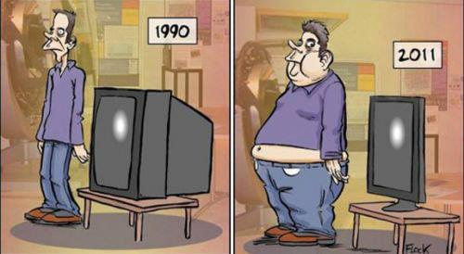
Overall idea
1980
2018

Slide 3
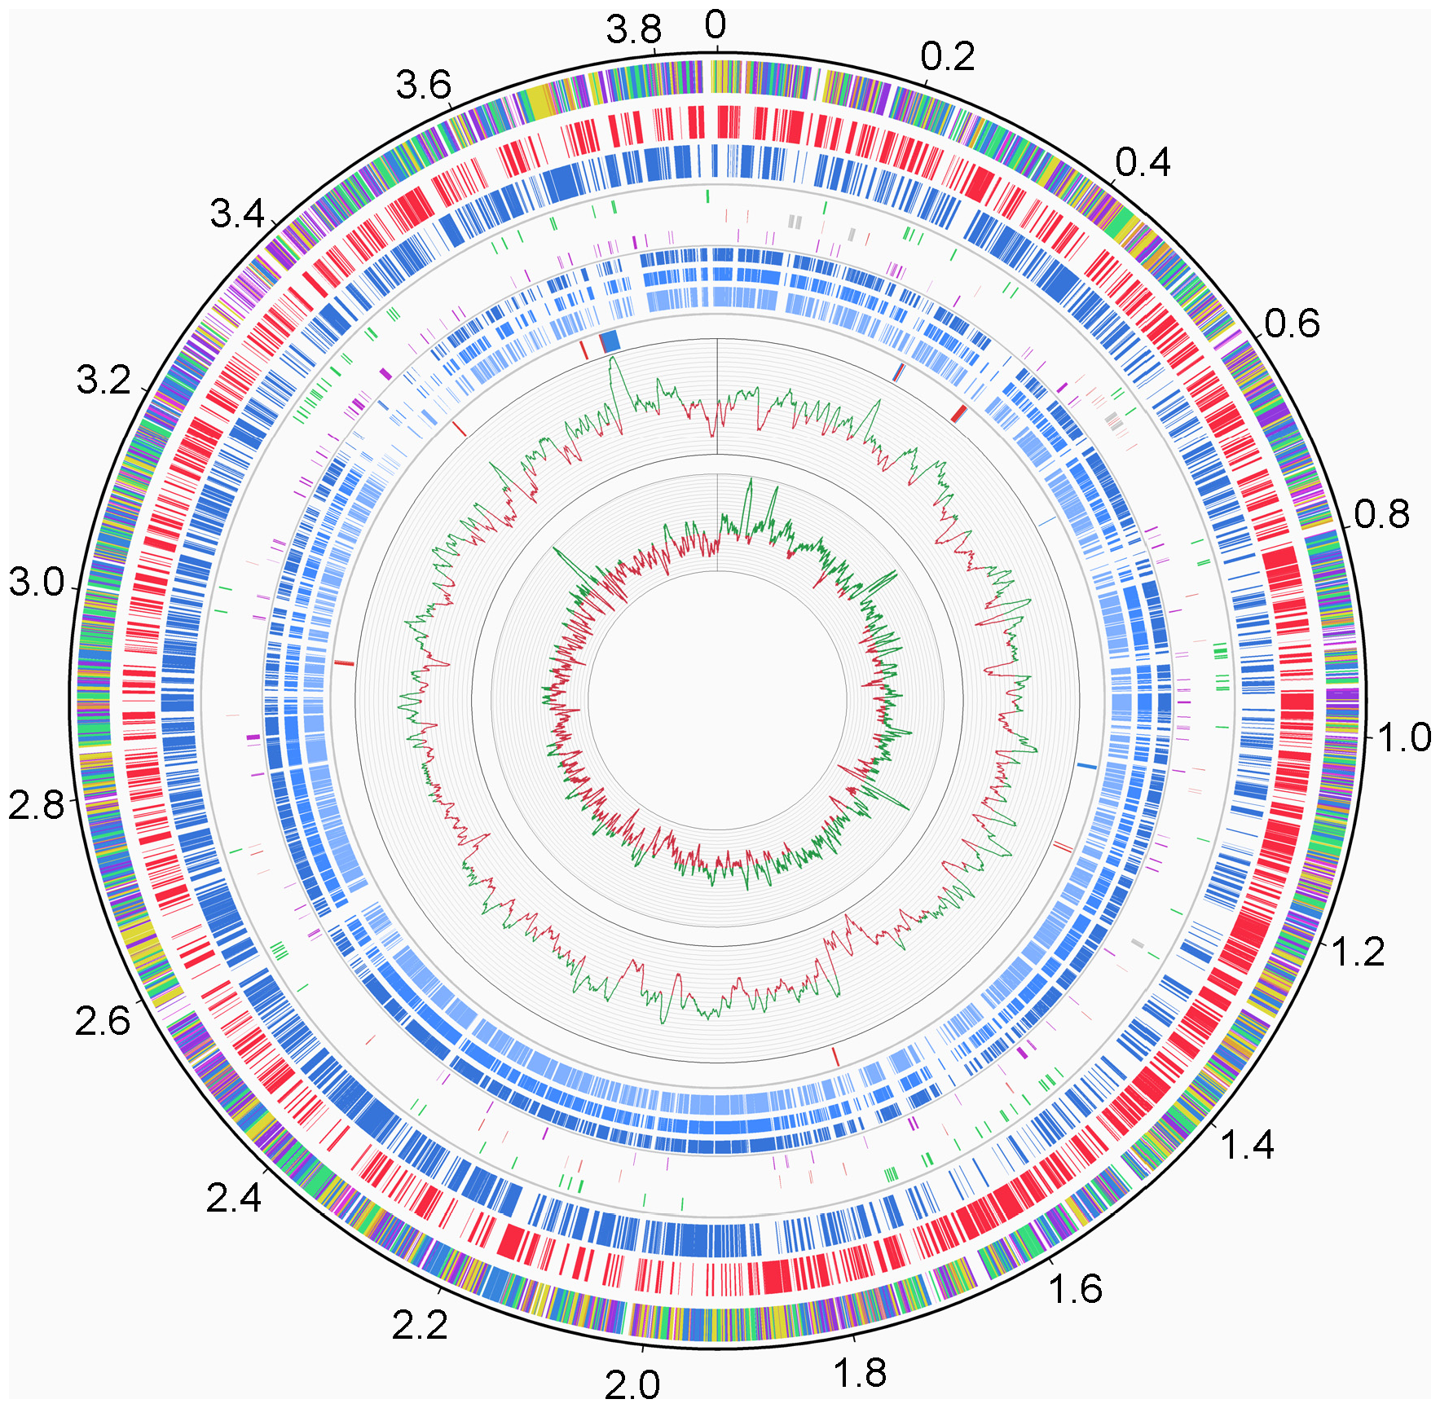
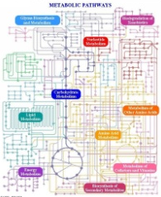
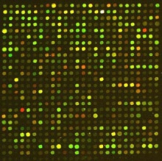
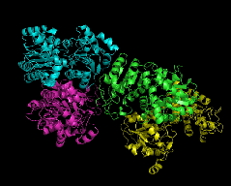
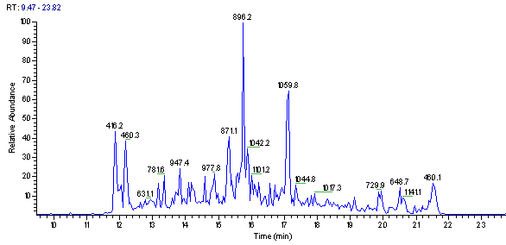
Systems Biology & Systems Medicine
Each living organism is surrounded by a virtual cloud of billions of data points.
The data is multi scale and heterogeneous.
It ranges from molecular and cellular data to all the way up to different environmental effects (e.g. social networks).
It is obvious that these big datasets have vast amount of noise.
Systems approaches gives us the tools to filter out the noise and to see what the data is all about.
Genomics
Transcriptomics
Proteomics
Metabolomics
Fluxomics

Slide 4
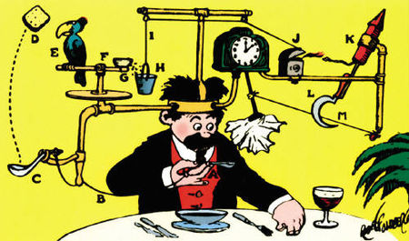
Systems Biology & Systems Medicine
Evolution created enormously complicated organisms and this random and chaotic process only work in particular environment.
Over the years complicated circuits are built on top of this complex structure.
To study and understand this complexity is a challenging task.
Rube Golberg’s inventions
Number of components
Their connection
Individual dynamics
System dynamics

Slide 5
Systems Biology & Systems Medicine
Computationally reduce the enormous data dimensionality to generate new hypothesize for different states.
Integrates high throughput omics data and generate predictive models.
This interdisciplinary field generates omics data to decipher the biological complexity.
Creates novel tools for dealing with the biological noise.
Systems Medicine: Specific to a medical question.
Focuses on the systems approaches for understanding human diseases and this may lead to the emergence of P4 medicine.
Revolutionize the current medical approaches via P4 medicine (Predictive, Preventive, Personalized & Participatory).

Slide 6
Systems Medicine
Holistic Approach for Disease
Infrastructure
Cross-Disciplinary
Systems Medicine
Emerging Technologies
Pioneering
Analytical Tools

Slide 7
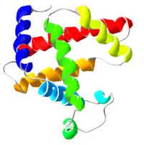
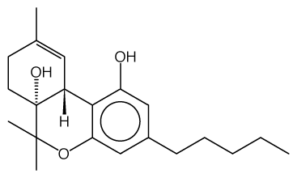
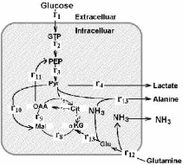
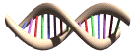
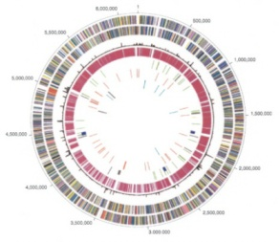
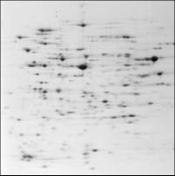
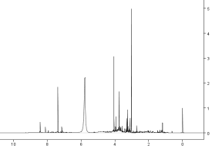
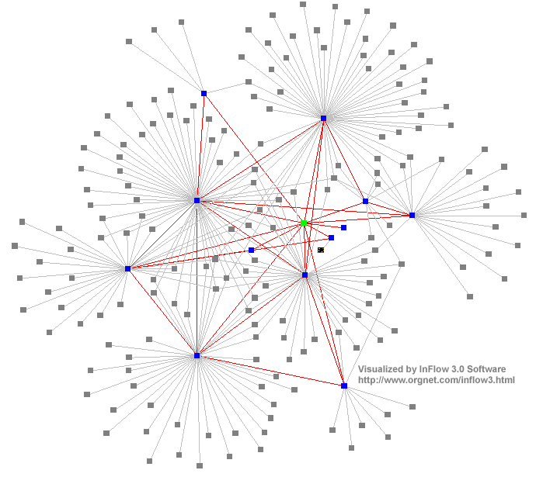
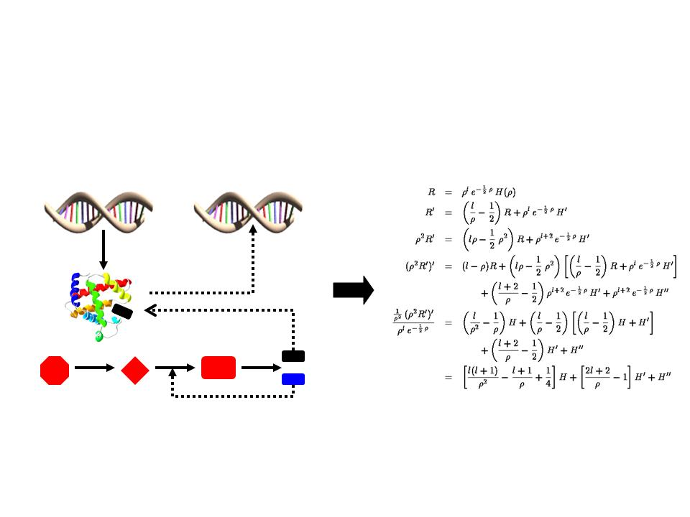
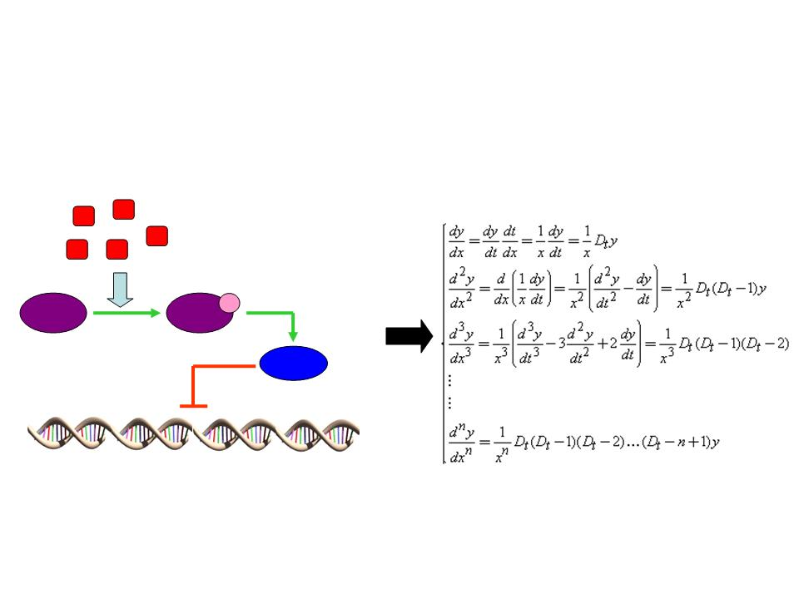
Top-Down & Bottom-Up SB
Genome
Transcriptome
Proteome
Metabolome
Fluxome
High throughput –omics data analyzed by bioinformatics
Discovery Based
Top-down Approach
Mathematical
Model of the System
Hypothesis Based
Bottom-up Approach
Cellular modules
7

Slide 8
Increasing Data Flow
8

Slide 9
Integration of omics data

Slide 10
GEMs: Genome-scale metabolic models
Reactions
Genes
Stochiometric matrix
Glucose
ATP[c]
GCK
ADP[c]
R₁
R₂
R₃
R₄
R₅
R₆
G6P
Glucose
G6P
F6P
F16BP
GAP
13BPG
3PG
DHAP
ATP
ADP
NAD+
NADH
Pi
H+
S
-1
1
0
0
0
0
0
0
-1
1
0
0
0
0
0
-1
10000000000
0
00
-1
1
0000
-1
1000
0
000
-1
1001000000
0000
-1
0000
0
-1
1
-1
1
00000
-1
10
-1
1
0000
GPI
F6P
ATP[c]
PFK
ADP[c]
F16BP
ALDO
DHAP[c]
TPI
GAP
NAD+[c], Pi[c]
GAPDH
NADH[c], H+[c]
13BPG
ATP[c]
PGK
ADP[c]
3PG
Mardinoglu & Nielsen (2012), JIM.

Slide 11
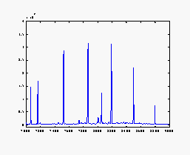
Genome-Scale Metabolic Models
Genome-scale metabolic models (GEMs) provide gene-protein-reaction connections and hereby allow for context dependent analysis
Co-regulated
Subnetwork
Identified
Independent Analysis
Network Dependent Analysis
A
E₁
P₁
Network
Dependent
Analysis
B
E₂
P₂
ATP
E₃
P₃
ADP
C
NAD⁺
P₄
NADH
E₄
P₅
Model
Simulations
D
Reaction
Protein
Genome Scale
Metabolic Model
Enzyme
Gene
PNAS (2005) 102:2685-2689; Mol. Sys. Biol. (2006) 2:50
Curr. Op. Microbiol. (2010) 13:255-262; J. Int. Med. 271:142-154
11

Slide 12
Construction of Metabolic Graphs
Enzyme interaction graph
Glc
Metabolic pathways
ATP
G6P
Hxk2
HXK2
ADP
Pgi
Pfk1
Hxk2
Pgi1
Pfk1
F6P
F1,6dP
Glc
G6P
F6P
F1,6dP
Bi-partite graph
ATP
ADP
ATP
ADP
Glc
ATP
G6P
Hxk2
ADP
Pgi
Pfk1
F6P
F1,6dP
12

Slide 13
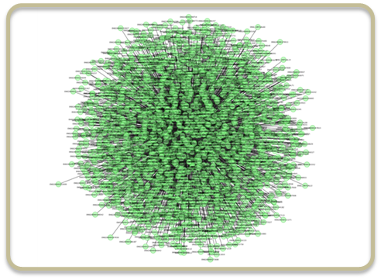
Metabolism of a single cell-type
Involves thousands of reactions in a coordinated fashion.
Reactions connected to each other through metabolites.
Each reaction is catalyzed one or more gene products.

Slide 14
Metabolic Graphs as Scaffolds for Integrative Analysis
Fructose 6P
NH3
Glucose 6P
GABAxt
NH3xt
GABAxt
PGI
PFK
Metabolic pathways
F6P
FBP
Metabolic graph
Reporter metabolites
Transcription data
PGI
Enzyme
Interaction graph
FBP
PFK
Subnetwork structures
PNAS (2005) 102:2685-2689
14

Slide 15
Uhlen et. al (2015), Science, 347: 1260419

Slide 16

Human Metabolic Atlas
Cell types
Tissues
Human

Slide 17
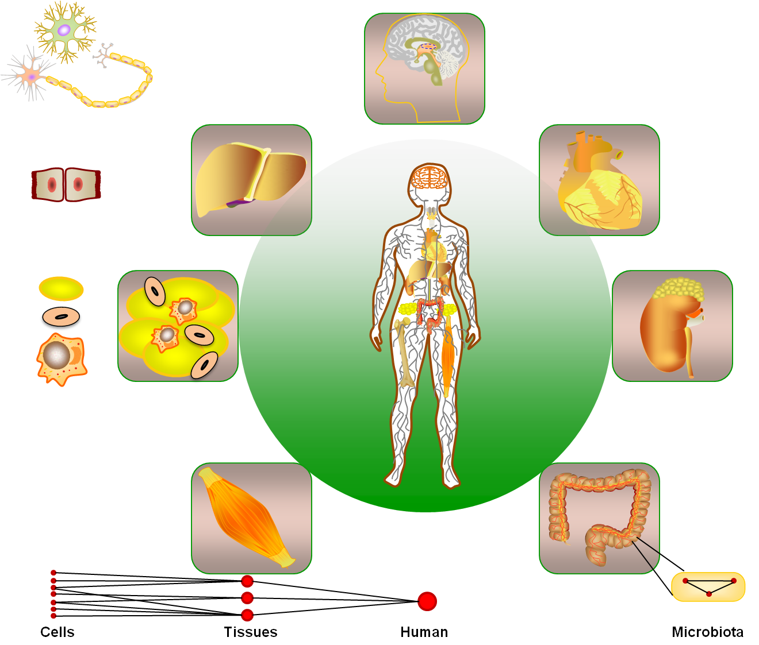
Whole body metabolism
Mardinoglu, Gatto & Nielsen (2013), Biotechnol. J.

Slide 18
Human Metabolic Atlas
Genotype
Environmental Factors
Diet
Toxins
Phenotype
Metabolism
Microbiota
HUMAN METABOLIC ATLAS
Model guided interpretation of dynamics
Molecular mechanisms
Subject segmentation
Biomarkers
Personalized Medicine
Mardinoglu & Nielsen (2012), JIM.

Slide 19
Human Metabolic Atlas
The overall objective of Human Metabolic Atlas:
Establishment of an interactive data analysis and model simulation platform provided through an open-acess website.
Construction of a database that includes continuously updated models as well as different clinical data.
Mapping of metabolic activities at pathway/reaction resolution for specific cell types and identify novel therapeutic targets and prognostic biomarkers.
Simulation of metabolic interactions between different tissues, i.e. whole body metabolism studies.
Visualization of high throughput data and results performed from metabolic studies.

Slide 20








Human Metabolic Atlas: The Vision
The Atlas will be an interactive database and modeling infrastructure that can be used for enriching the value of clinical data
Clinical Data
(serum chemistry, tissue specific data, …)
Analysis & visualization
Biomarkers
Metabolic simulations
Drug development
Human Metabolic Atlas
Tissue specific models
Circulation model
Databases
www.metabolicatlas.org
External Databases
& Clinical Data
External Databases
20

Slide 21

Human Metabolic Atlas
Whole body simulations
Omics data analysis
Genome-scale metabolic models
Molecular mechanisms
Therapeutic agents
Drug targets
Novel biomarkers
PERSONALIZED AND TRANSLATIONAL MEDICINE
Mardinoglu, Gatto & Nielsen (2013), Biotechnol. J.

Slide 22
Tissue Specific Models
We are developing a Human Metabolic Atlas that comprise genome-scale metabolic models for each human tissue
May allow for advanced diagnosis required for development of personalized medicines
Liver
Lipid metabolism
Detoxification
Glucose metabolism
Gut Microbiome
Skeletal Muscle
Fiber metabolism
Depolymerization
Organic acid
production
Sugar and lipid
catabolism
Protein synthesis
22

Slide 23
Reconstruction of Cell Type Specific Models by INIT
Human Metabolic Reaction (HMR) Database
PLoS Comp. Biol. (2012) 8:e1002518
23

Slide 24
The INIT Algorithm
The algorithm find a network where:
All reactions can have a flux…
…all metabolites that are detected by metabolomics can be produced…
…where as many metabolites as possible can be produced…
…and where the sum of the scores for the reactions is as large as possible
PLoS Comp. Biol. (2012) 8:e1002518
24

Slide 25
Comparison with Manual Liver Model
The 165 genes in the manual model and not in our database (and hence our model) encode primarily transporters to sinusoidal space
The 105 genes in HepatoNet1 and not in our model are mainly coding for iso-enzymes (reactions are in our model)
PLoS Comp. Biol. (2012) 8:e1002518
25

Slide 26
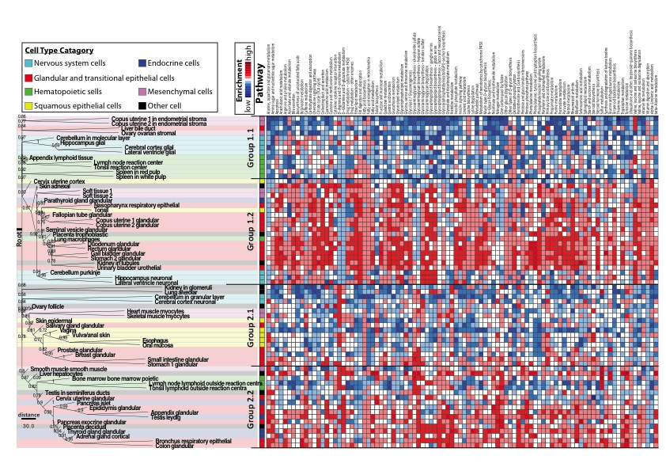
GEMs for 69 Human Cell Types
Different cell types clearly have specialization in terms of metabolic functions
KEGG Metabolic Pathway
Cell Type

Slide 27
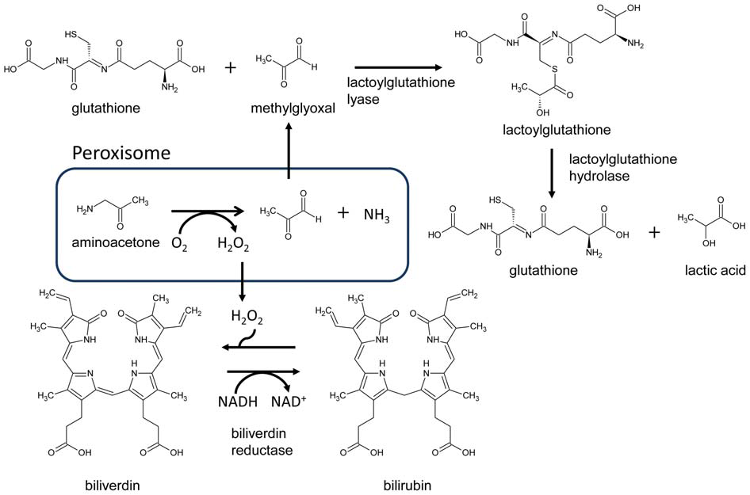
Difference between 16 Cancers and 69 Normal Cell Types
Known differences identified:
Polyamines
Isoprenoids
Prostaglandins
All models available at www.metabolicatlas.org
Identification of a consensus metabolic networks present in 16 cancers and not present in normal cell types
PLoS Comp. Biol. (2012) 8:e1002518
27

Slide 28
Second Generation Models
28

Slide 29
Updated HMR database
HMR database
898
EHMN
GEMs | Reactions | Metabolites | Genes
HMR database | 8107 | 6049 (3162)* | 3668
iHuman1512 | 5535 | 3397 | 1512
Recon 1 | 3402 | 2785 | 1477
EHMN | 6216 | 2678 | 2482
HepatoNet1 | 2519 | 777 | 713
iAB586 | 649 | 493 | 586
Recon1
163
719
1175
65
543
55
50
HepatoNet 1
* 95 % of the reactions can carry flux
* HMR covers 82 % of the enzymes
The HMR database is the most comprehensive reaction database available
The updated HMR database will be used to reconstruct 2. generation models
Will be made available in new version of www.metabolicatlas.org that will also include visualization tools
Mardinoglu et. al (2013), Mol Syst Bio, 9: 649
29

Slide 30
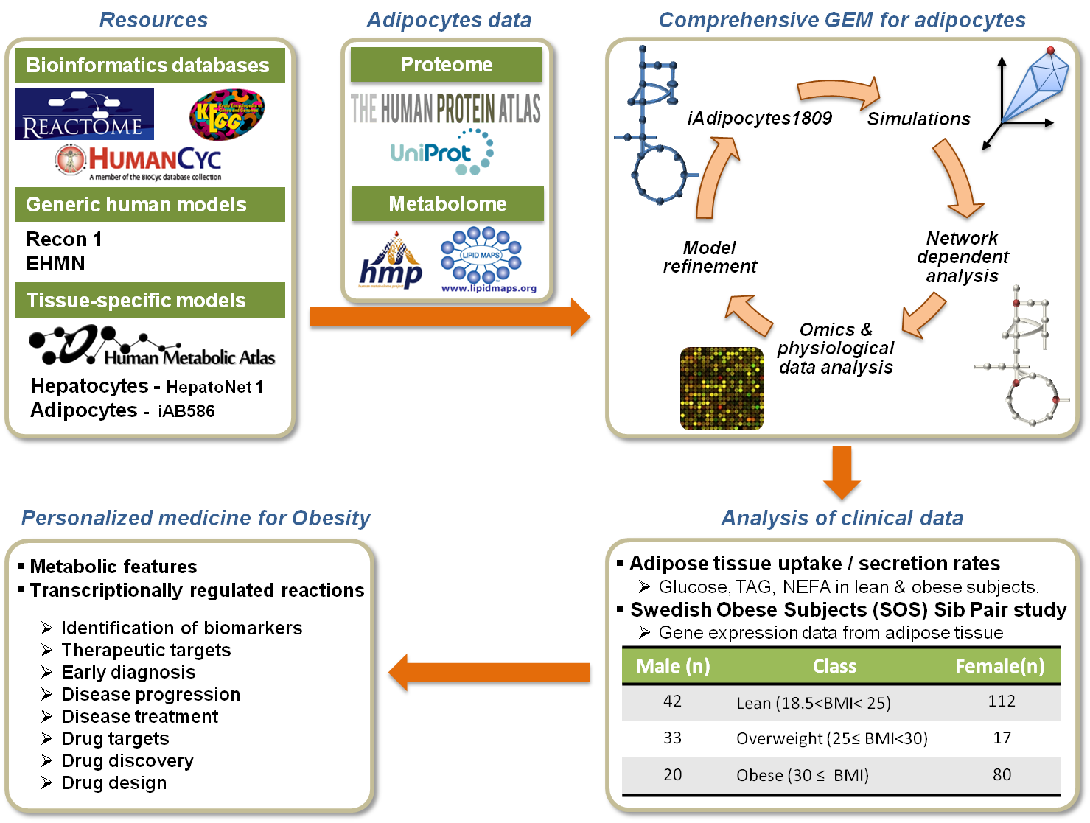
Workflow-1: Adipocyte Model
Mardinoglu et. al (2013), Mol Syst Bio, 9: 649
30

Slide 31
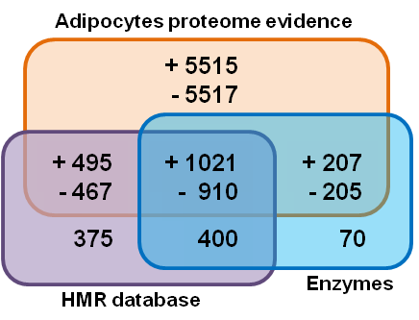
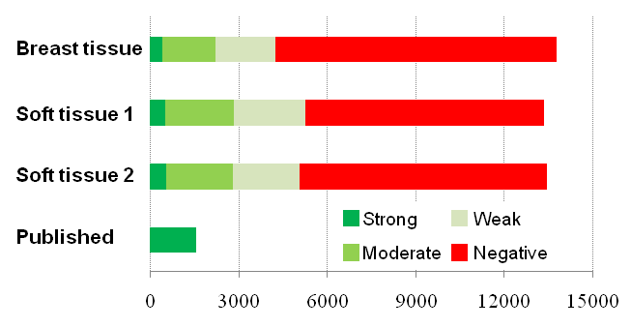
Identification of Enzymes
Using immunohistochemistry and antibodies generated withing the Human Protein Atlas we evaluated the presence of 14,077 proteins in adipocytes in 3 different tissue samples. Together with published proteome data, we identified proteins associated with 7,340 genes in adipocytes.
This led to identification of adipocyte enzymes associated with 1,628 genes
Mardinoglu et. al (2013), Mol Syst Bio, 9: 649
31

Slide 32
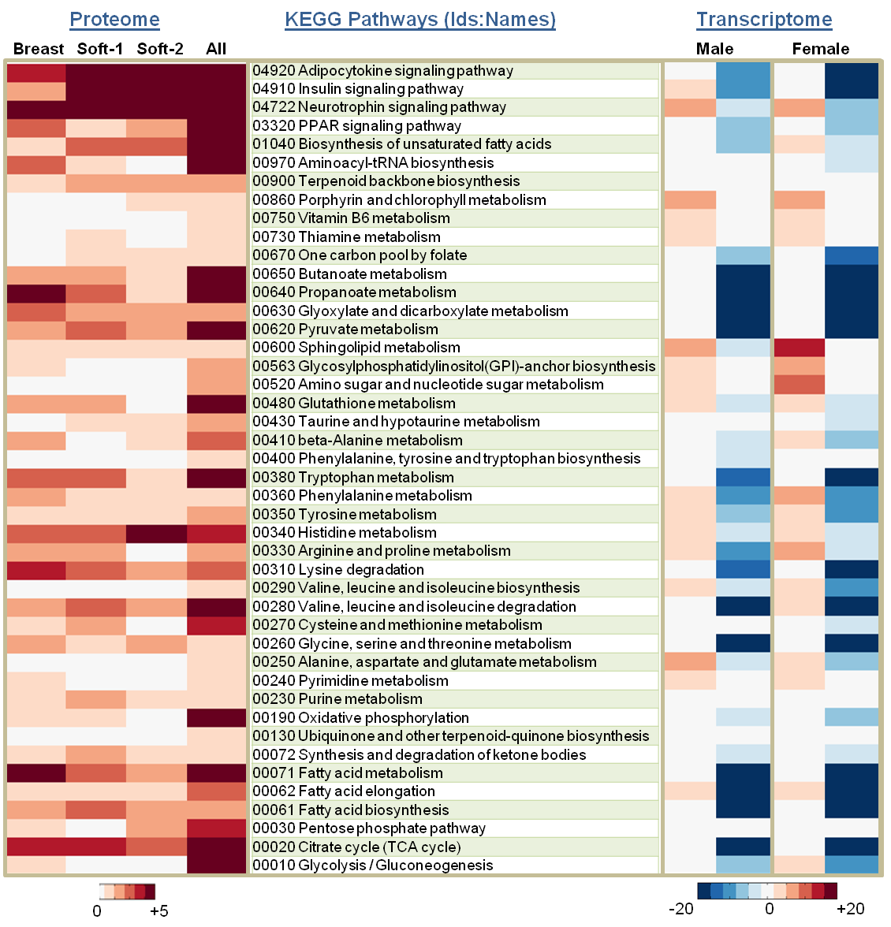
We further used transcriptome data to identify 1,078 differentially expressed genes between lean and obese (both male and females)
Using genes identified from proteome and transcriptome data we reconstructed a GEM for adipocyte
Contains enzymes associated with 1,809 genes
Mardinoglu et. al (2013), Mol Syst Bio, 9: 649
32

Slide 33



Reactions in adipocyte model
DATABASES
GEMs
We generated HMR database by merging the published literature based GEMs and human metabolism related reactions in public databases.
HMR database represents the most comprehensive human metabolic reaction database for genome-scale modeling
HMR database contains
6,049 metabolites
8 compartments
8,107 reactions
3,668 genes
75 % of the reactions are associated to one or more genes.
Recon 1
EHMN
HepatoNet 1
Human metabolic reaction
(HMR) database
A
P₁
T₁
G₁
B
P₂
T₂
G₂
ATP
P₃
T₃
ADP
G₃
C
?
D
T₄
NAD+
P₄
G₄
NADH
T₅
E
P₅
T₆
P₆
T₇
G₅
F
Reaction
Protein
Transcript
Gene
Mardinoglu et. al (2013), Mol Syst Bio, 9: 649
33

Slide 34
Reconstruction of iAdipocyte1809
Human metabolic reaction (HMR) database
iAdipocyte1809 is the most
comprehensive GEM for human cells
GEMs | Reactions | Metabolites | Genes
HMR database | 8107 | 6049 | 3668
iAdipocyte1809 | 6169 | 4595 | 1809
Recently generated proteome data (HPA)
Previously published proteome data
Significant expressed genes in obese subjects
Subcellular location of proteins (HPA &UniProt)
iAdipocytes1809
iAdipocytes1809
Mardinoglu et. al (2013), Mol Syst Bio, 9: 649
34

Slide 35
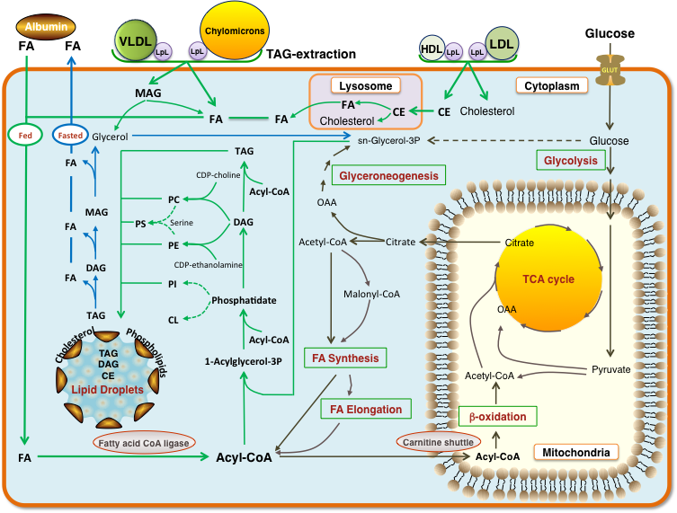
Functionality of iAdipocyte1809
iAdipocytes1809 contains a comprehensive description of lipid biosynthesis, including lipid droplet formation
Mardinoglu et. al (2013), Mol Syst Bio, 9: 649
35

Slide 36
Simulation of LD formation
We used measurements of McQuaid et al. (Diabetes (2011) 60:47-55), who measured uptake of glucose and TAG as well as NEFA release from adipocytes in lean and obese subjects, to perform simulation of adipocyte metabolic function.
Mardinoglu et. al (2013), Mol Syst Bio, 9: 649
36

Slide 37
Simulation of LD formation
The model can simulate formation of lipid droplets (LDs) and there is found to be a higher specific activity of adipocytes in lean subjects
Mardinoglu et. al (2013), Mol Syst Bio, 9: 649
37

Slide 38
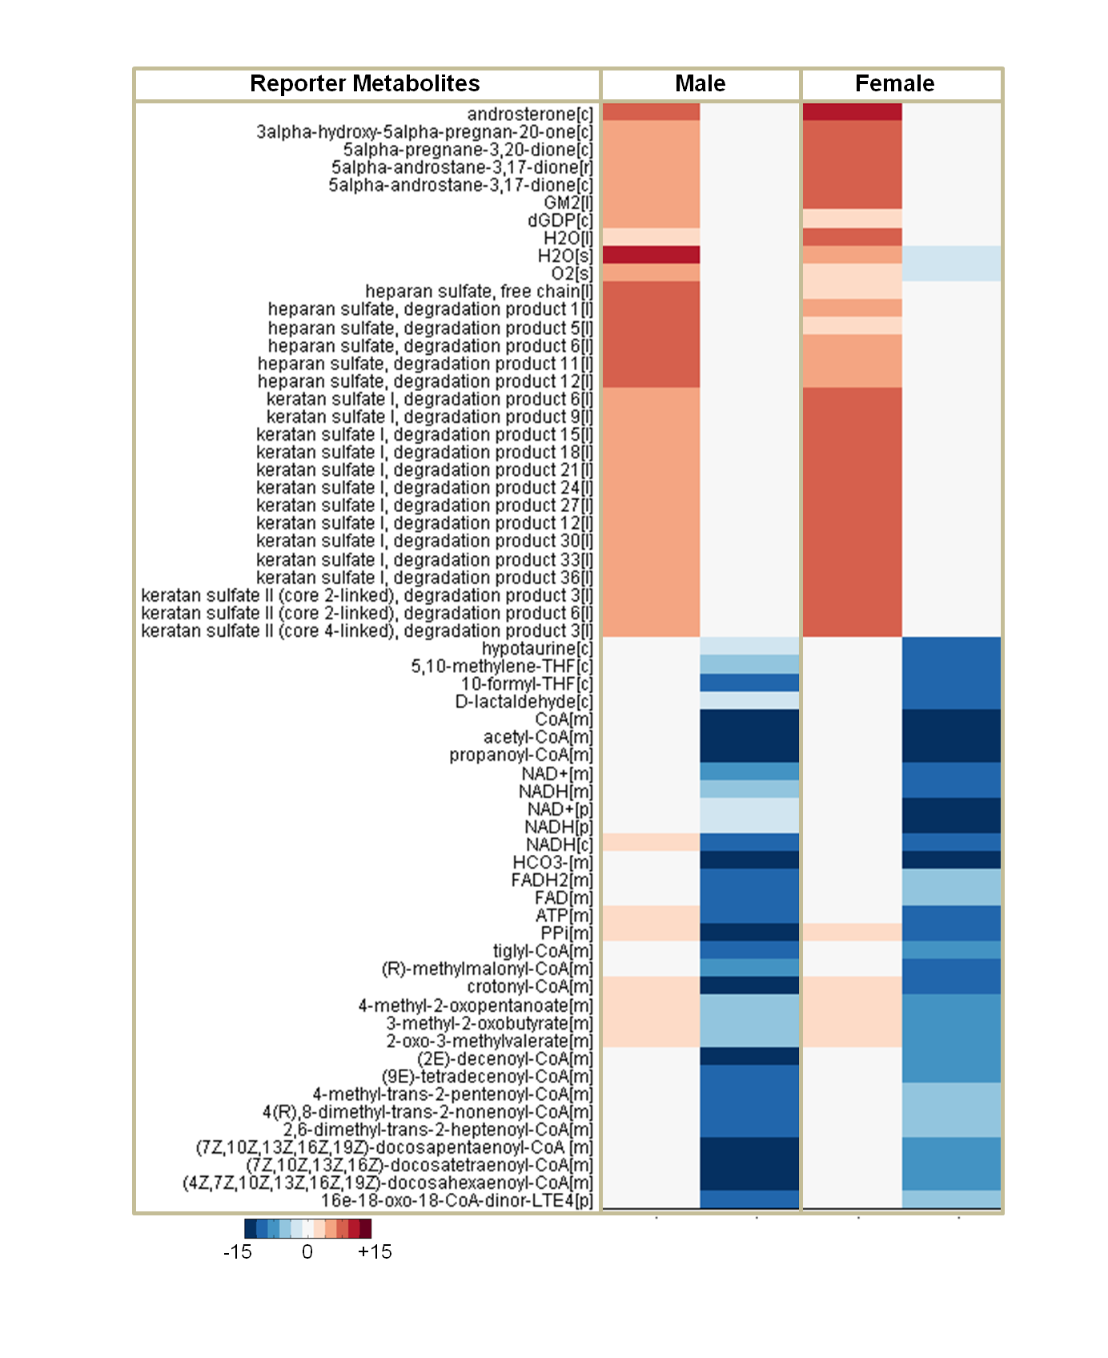
Reporter Metabolites
Several key reporter metabolites were identified: androsterone (found in serum of obese), gangliosides, heparan sulfate proteoglycans
Many metabolites associated with mitochondria and β-oxidation are ”down” in obese
38

Slide 39
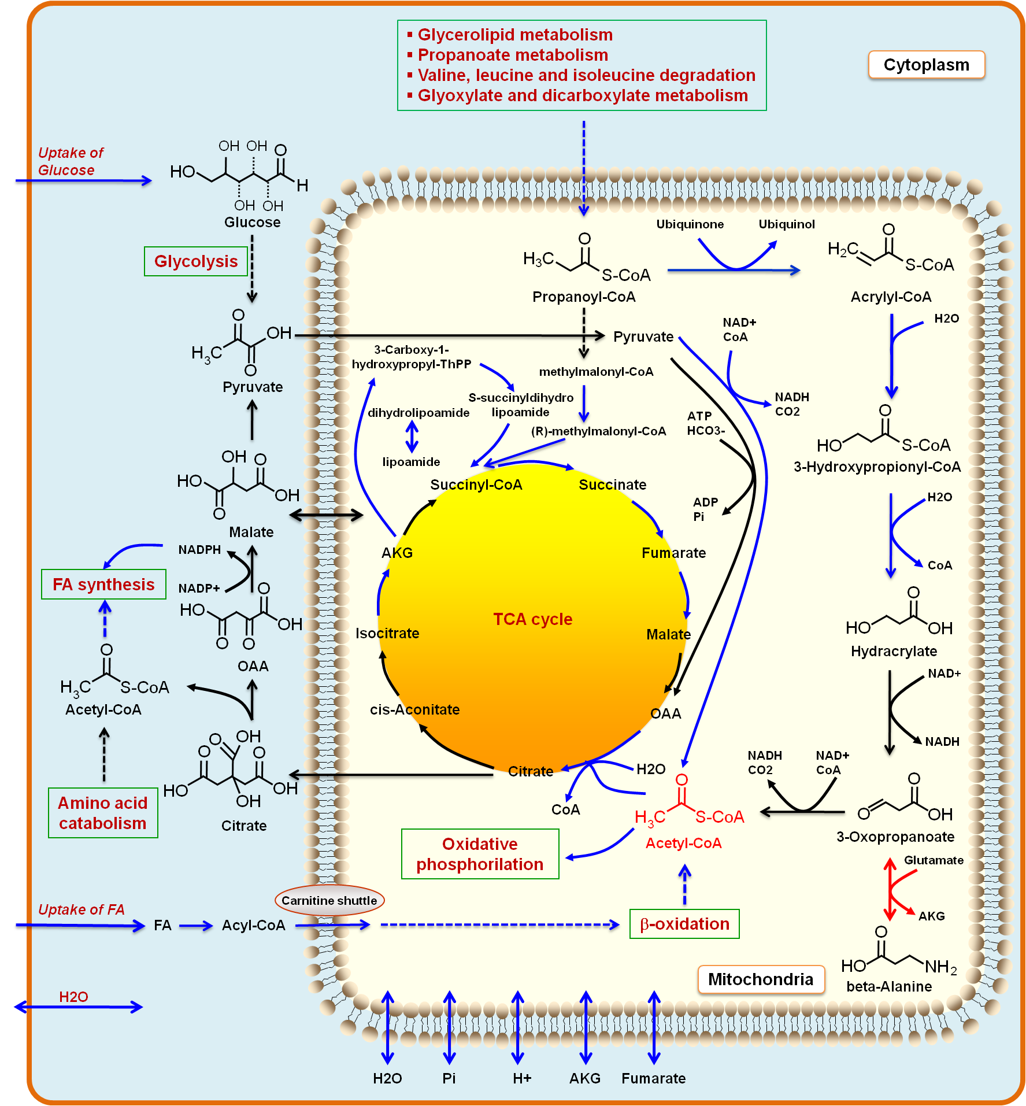
Random Sampling
We used our random sampling algorithm to identify metabolic fluxes that are transcriptional regulated between lean and obese
Down-regulated in obese
Glucose uptake
FA uptake
FA synthesis
β-oxidation
TCA cycle
39

Slide 40


Workflow-2: Hepatocytes Model
Reannotation
HMR Database
GEM for hepatocytes
Literature based GEMs
Generic human GEMs
iHepatocytes2255
iHuman1512
Recon 1
Edinburgh model (EHMN)
Hepatocytes models
NAFLD transcriptome
Cell type specific GEM
iAdipocytes1809
HepatoNET 1
Network dependent analyses
Pathway / process databases
Reporter Metabolites
Reporter Subnetworks
Discovery of biomarkers
Diagnose NASH
Subcategorize NAFLD
Identification of therapeutic targets
New drug targets
Mardinoglu et. al (2014), Nat Commun, 5: 3083
40

Slide 41
Reconstruction of iHepatocyte
A concensus GEM for hepatocytes have been reconstructed based on improved proteme data and previously published models.
iHepatocyte2250
iHepatocyte2250
956
iLJ1046
120 genes in HPA are reannotated using different antibodies
iAB676
70
153
358
34
419
116
144
HepatoNet 1
iHepatocyte2250 have been used for the analysis of gene expression data obtained from NAFLD patients.
Mardinoglu et. al (2014), Nat Commun, 5: 3083
41

Slide 42
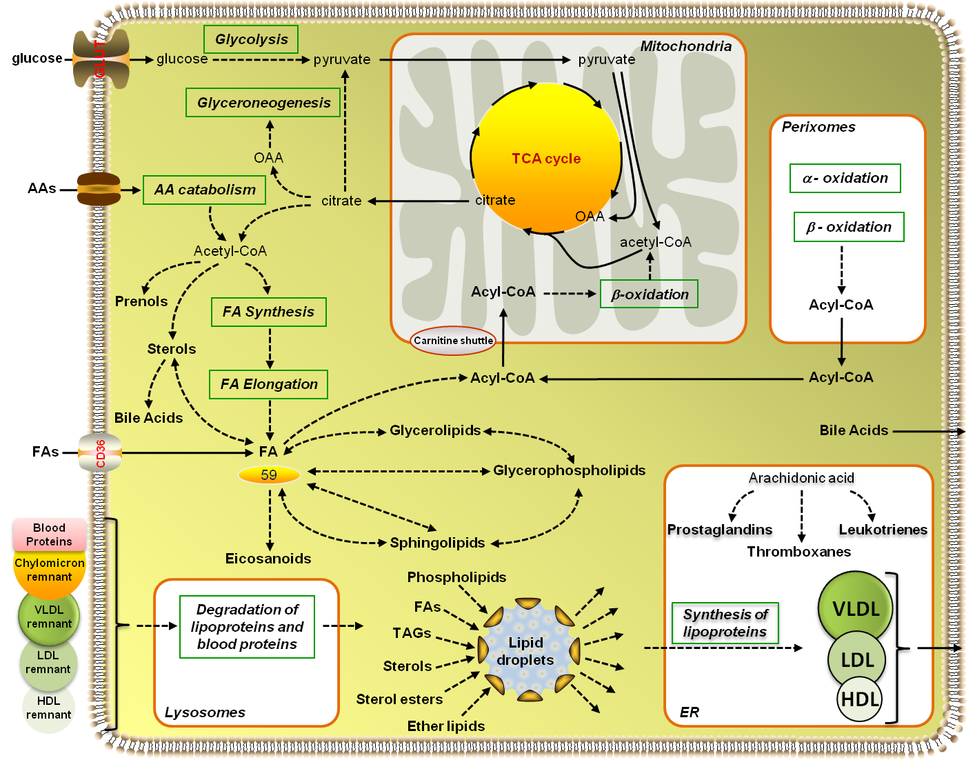
Functionality of iHepatocytes2255
iHepatocytes2255 contains a comprehensive description of lipid metabolism,
Degradation of lipoproteins
Formation of Lipid droplets
Synthesis of lipoproteins
Other components of lipid metabolism
iHepatocytes2255 is reconstructed considering the interplay between iAdipocytes1809 and can be used for studting the whole body metabolism related studies.
Mardinoglu et. al (2014), Nat Commun, 5: 3083
42

Slide 43
Metabolic differences in NAFLD
NASH with Fatty Liver
>5% fat deposition
<5% fat deposition
within hepatocytes
Healthy
Steatosis
NASH without Fatty Liver
Non-alcoholic fatty liver disease (NAFLD)
Considered as the hepatic manifestation of obesity and metabolic syndrome
Lipid accumulation is one of its hallmark.
Liver biopsy is commonly used even though it has several drawbacks
There is no effective treatment strategy for NASH!!!!
iHepatocytes2255 is employed for analyzing liver gene expression data
45 Liver samples
9 NASH with fatty liver (NASH with FL)
7 NASH without fatty liver (NASH without FL)
10 Steatotic
19 Healthy
Mardinoglu et. al (2014), Nat Commun, 5: 3083
43

Slide 44
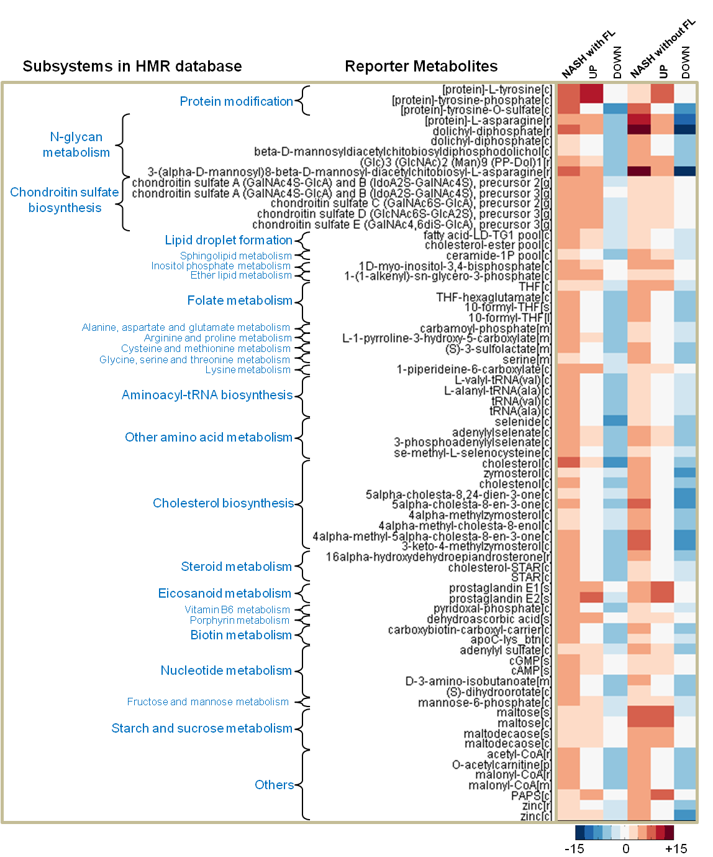
Reporter Metabolites
In addition to the Reporter Metabolites in the known subsystems involved in NASH
cholesterol biosynthesis, folate, vitamin B6, porhyrin, nucleotide, eicosanoid and amino acid metabolism;
new Reporter Metabolites are identified in N-glycan metabolism and Chondroitin Sulfate synthesis.
Mardinoglu et. al (2014), Nat Commun, 5: 3083
44

Slide 45
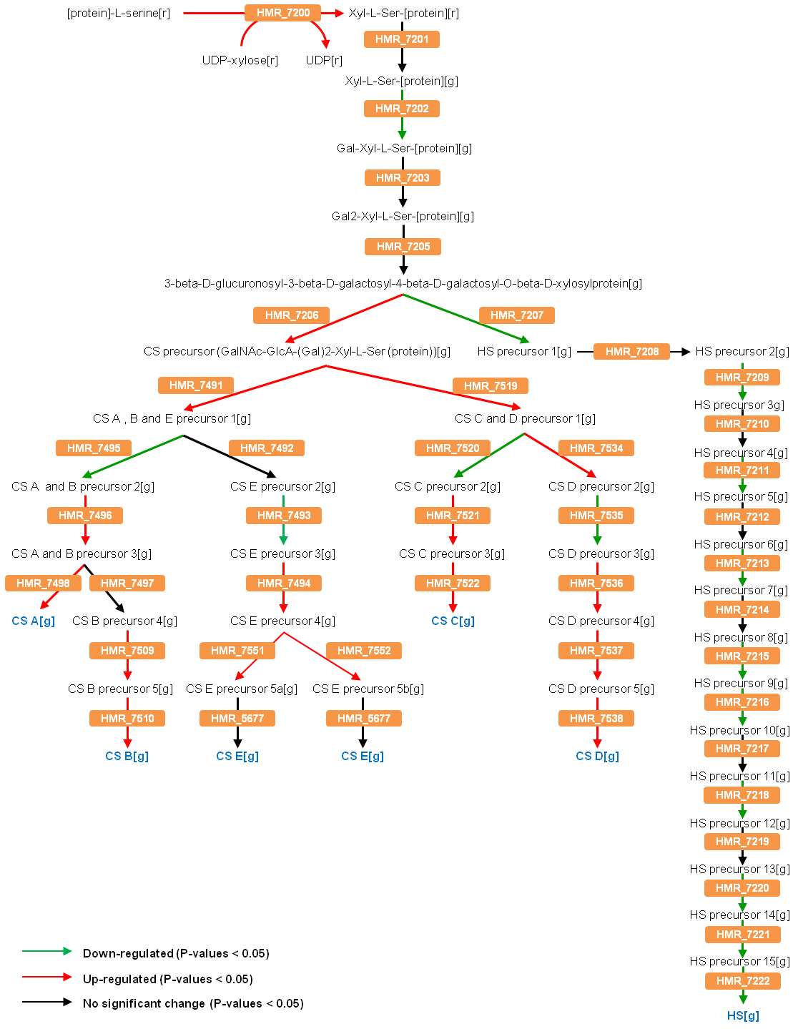
Biomarkers for NASH
In order to gain more knowledge about the metabolic differences around proteoglycans, the detailed Chondroitin Sulfate and Heparan Sulfate biosynthesis pathway and the gene expression changes in NASH patients versus healthy subjects were identified.
We propose that Chondroitin Sulfate and Heparan Sulfate can be used for diagnosing NASH and subcategorizing NAFLD patients.
Mardinoglu et. al (2014), Nat Commun, 5: 3083
45

Slide 46
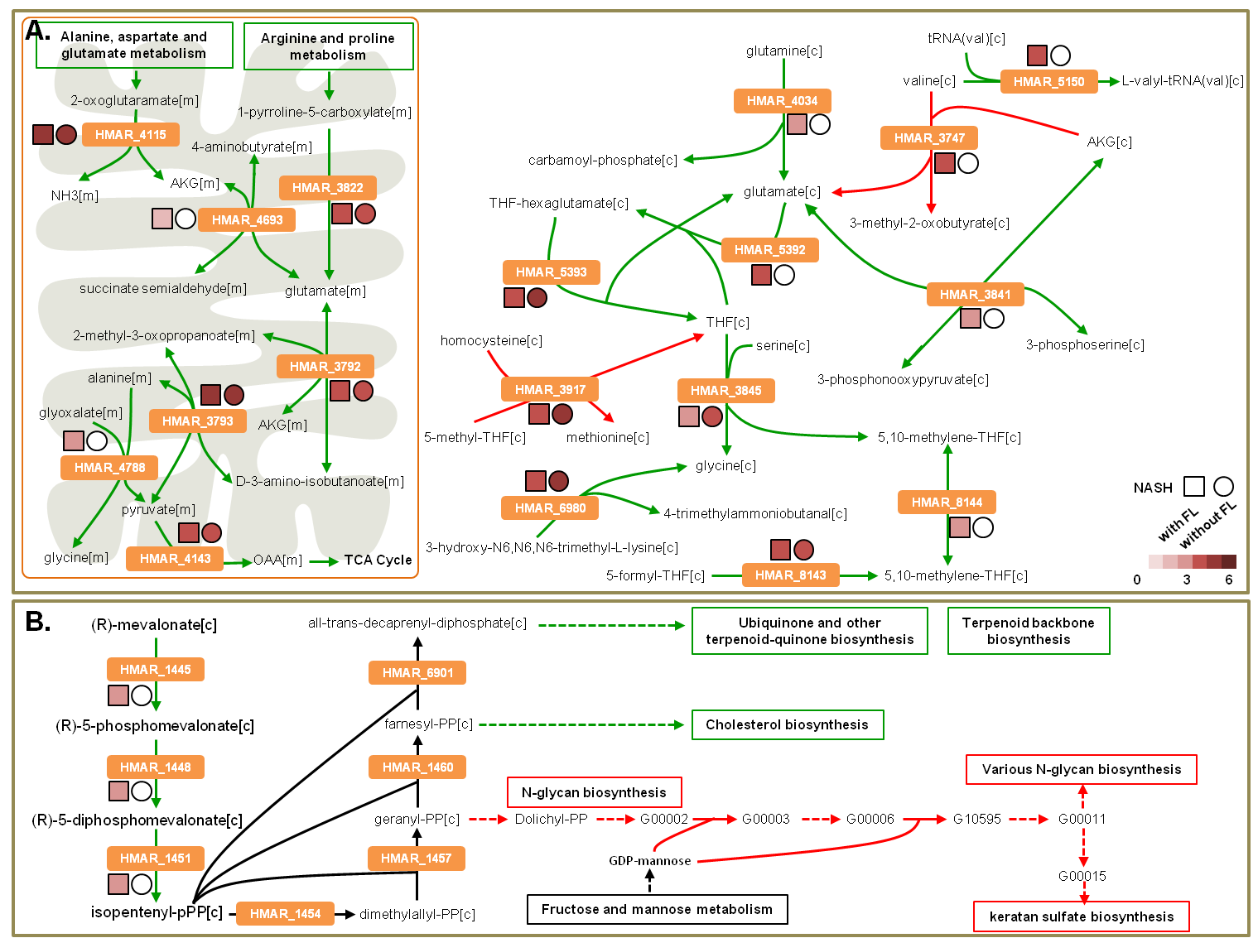
Reporter sub-networks identified between two stages of NASH and healthy liver
Mardinoglu et. al (2014), Nat Commun, 5: 3083
46

Slide 47
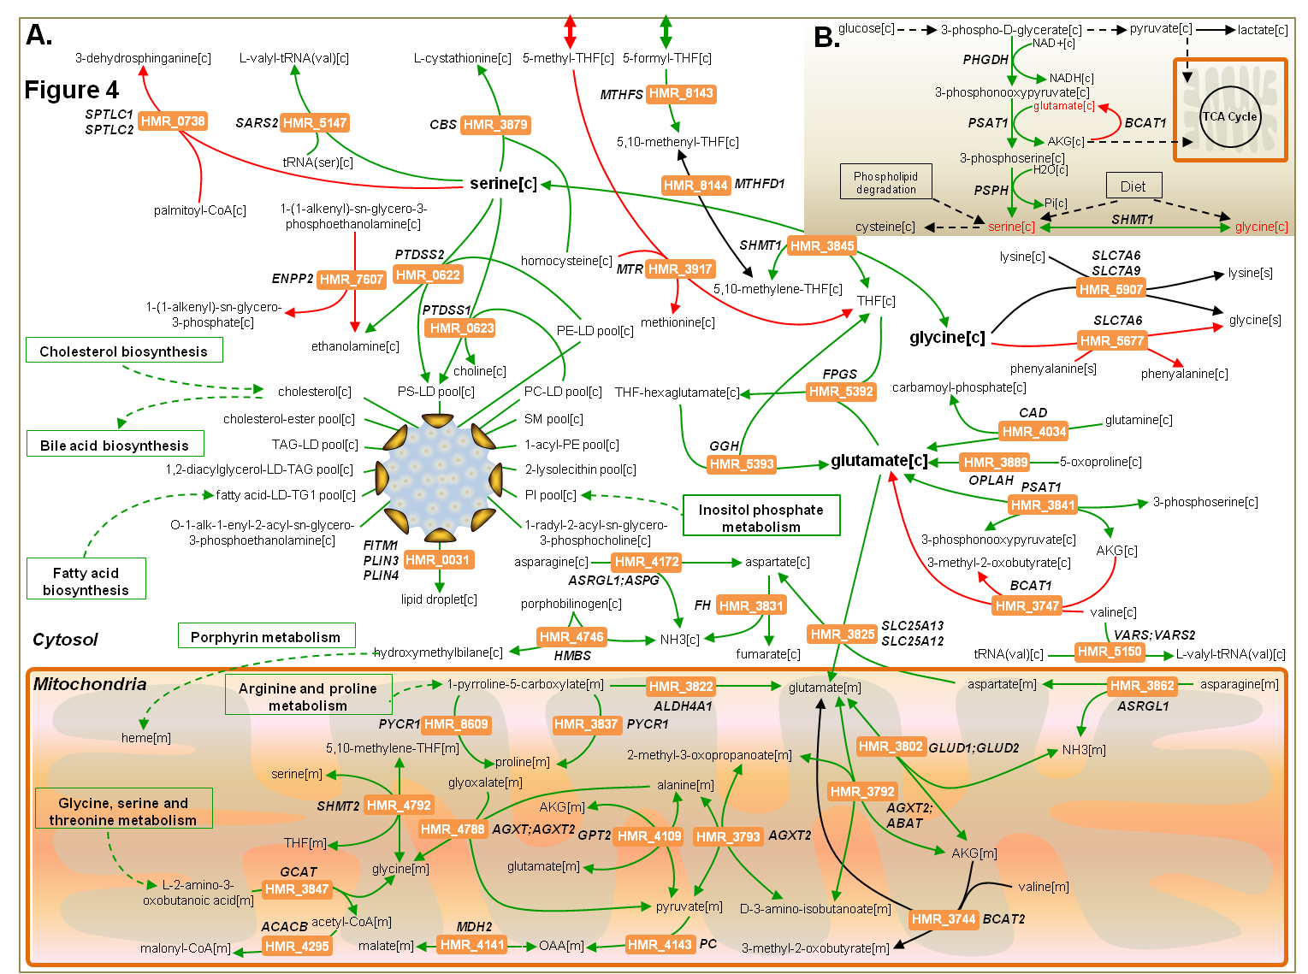
Reporter Subnetworks identified between two stages of NASH versus healthy liver.
Metabolic differences around serine and glutamate were identified.
Mardinoglu et. al (2014), Nat Commun, 5: 3083
47

Slide 48
Mitochondrial dysfunction in NASH
Cytosol
Mitochondria
alanine[m]
alanine[m]
lactate[c]
AKG[m]
alanine[m]
NAD+[m]
S-acetyldihydrolipoamide[m]
2-oxoglutaramate[m]
HMR_4109
HMR_4197
HMR_4388
HMR_3793
H+[m]
NADH[m]
CO2[m]
HMR_6410
glutamate[m]
glutamine[m]
2-methyl-3-oxopropanoate[m]
lipoamide[m]
D-3-amino-isobutanoate[m]
glucose[c]
3-phospho-D-glycerate[c]
pyruvate[c]
pyruvate[m]
HMR_4280
L-lactate[m]
3-phosphonooxypyruvate[c]
H+[m]
NADH[m]
NAD+[m]
AKG[c]
AKG[c]
AKG[m]
ATP[m]
H+[m]
HCO3-[m]
TCA cycle
3-phosphoserine[c]
isocitrate[m]
ADP[m]
Pi[m]
CoA[m]
NAD+[m]
serine[c]
cis-aconitate[m]
HMR_4143
citrate[c]
citrate[m]
HMR_4137
OAA[m]
CO2[m]
H+[m]
NADH[m]
acetyl-CoA[m]
Decreased AKG flux on TCA cycle should be balanced by the increased flux through mitochondrial pyruvate.
In NASH patients reactions involving mitochondrial pyruvate is also down regulated. (Mitochondrial dysfunction similar to our findings in the adipose tissue of obese patients.)
Mardinoglu et. al (2014), Nat Commun, 5: 3083
48

Slide 49
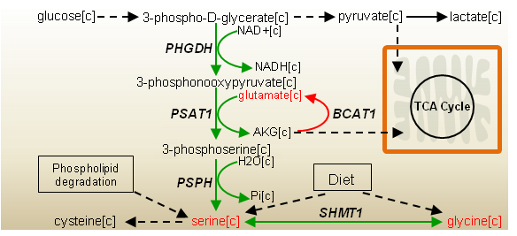
Proposed targets for NASH
Serine level can be increased through its supplement.
SHMT1 can be amplified in order to increase the serine level.
However, these two solutions do not increase the AKG transported to mitochondria.
PSPH rate limiting enzyme in liver can be amplified in order to produce more serine in NASH patients and this may increase the AKG transported to mitochondria and overcome mitochondrial dysfunction.
Similarly BCAT1 can be inhibited and increased level of glutamate can be converted to AKG.
Our solutions are supported by the metabolomics study in NASH patients where they reported decreased level of serine and increased level of glutamate.
Mardinoglu et. al (2014), Nat Commun, 5: 3083
49

Slide 50
Workflow-3: Personalized Models
Tasks driven functional GEM reconstruction through INIT
HMR Database
Literature based GEMs
Personalized GEMs
for Liver cancer
Generic human GEMs
Functional analysis
iHuman1512
Recon 1
Edinburgh model (EHMN)
6 HCC patients
4 CCC patients
Cell type specific GEM
iAdipocytes1809
HepatoNET 1
Pathway / process databases
Cell type GEMs
82 Healthy cells
iHepatocytes1650
20 Cancer
New drug targets
A new algorithm for automated reconstruction of functional GEMs was developed.
Personalized GEMs for liver cancer patients were reconstructed.
New algorithm is used to update our models.
Potential drug targets were identified using a novel approach.
Agren et. al (2014), Mol Syst Bio. 10:721
50

Slide 51
Proteome for Liver Cancer Patients
PATIENT ID | SEX | AGE | LIVER CANCER TYPE
Patient 2556 | Male | 72 | HepatocellularCarcinoma
Patient 2766 | Female | 73 | HepatocellularCarcinoma
Patient 2177 | Female | 58 | HepatocellularCarcinoma
Patient 3196 | Male | 65 | HepatocellularCarcinoma
Patient 3477 | Male | 67 | HepatocellularCarcinoma
Patient 2280 | Male | 80 | HepatocellularCarcinoma

Slide 52
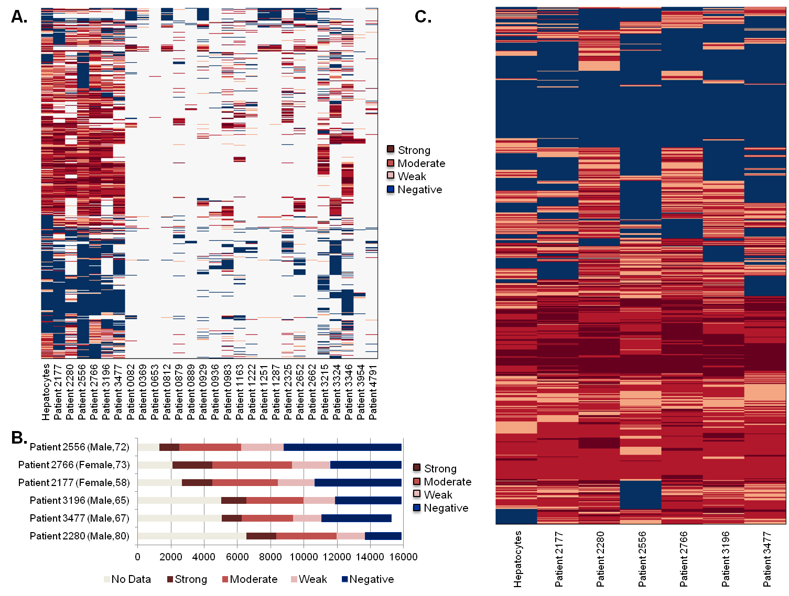
Proteomics data for HCC tumors
Agren & Mardinoglu et. al (2014), Mol Syst Biol, 10:721
52

Slide 53
Task driven reconstruction with tINIT
tINIT algorithm is improved based on Task driven reconstruction approach.
Biological tasks are defined based on the biochemical knowledge in the literature
m8 and m12 is produced in the model based on the HPA data
m9 is produced based on the biological task that occur in the cell type.
P1
P2
P3
m1
m3
m4
m8
P4
P5
m2
m6
m5
m11
P6
P10
P7
P8
P9
m7
m10
m9
m12
Strong
Moderate
Weak
Negative
Synthesis of m9
PLoS Comp. Biol. (2012) 8:e1002518
53

Slide 54
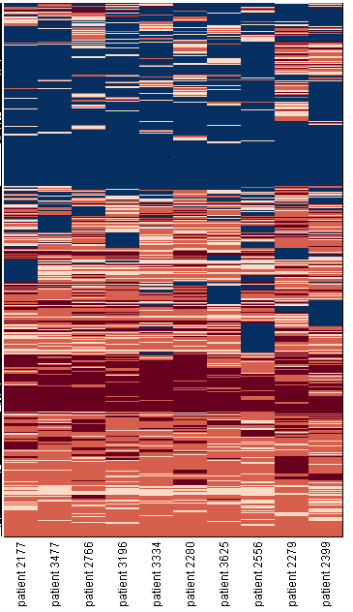
Personalized GEMs
HPA proteomics data
Personalized GEMs
tINIT
60 functions that exist in all cells
Includes:
Energy and redox functions
Uptake of building blocks
Synthesis of central metabolites
Some catabolic functions, such as beta oxidation
10 patients with at least 1700 metabolic genes measured
Significant differences in which genes that were measured
Two different types of liver cancers
54

Slide 55
Personalized model differences
Patient 2556
Patient 2766
Patient 2177
Patient 3196
Patient 2280
Patient 3477
Generic HCC
Patient 2556
Patient 2766
Patient 2177
Patient 3196
Patient 2280
Patient 3477
Generic HCC
Reactions
Genes
Patient 2556
Patient 2766
Patient 2177
Patient 3196
Patient 2280
Patient 3477
Generic HCC
- | 4545 | 4458 | 4437 | 4517 | 4463 | 4506
567 | - | 4673 | 4594 | 4699 | 4686 | 4713
597 | 444 | - | 4541 | 4661 | 4650 | 4701
580 | 543 | 505 | - | 4598 | 4519 | 4566
610 | 523 | 455 | 522 | - | 4624 | 4660
597 | 428 | 356 | 559 | 539 | - | 4685
494 | 357 | 237 | 448 | 450 | 279 | -
Patient 2556
Patient 2766
Patient 2177
Patient 3196
Patient 2280
Patient 3477
Generic HCC
- | 1606 | 1507 | 1531 | 1596 | 1504 | 1556
512 | - | 1701 | 1729 | 1808 | 1694 | 1722
524 | 430 | - | 1634 | 1707 | 1617 | 1656
513 | 411 | 415 | - | 1736 | 1632 | 1671
548 | 418 | 434 | 413 | - | 1685 | 1731
510 | 424 | 392 | 399 | 458 | - | 1680
382 | 344 | 290 | 297 | 342 | 222 | -
4400
4500
4600
4700
4800
1500
1600
1700
1800
1900
Similarities
Similarities
200
300
400
500
600
700
200
300
400
500
600
700
Differences
Differences
Agren & Mardinoglu et. al (2014), Mol Syst Biol, 10:721
55

Slide 56
Testing drugs
Effect of using an antimetabolite to the ”purple metabolite”
No one has yet implemented the effect of drugs in a GEM framework
One type of drugs are the so called ”antimetabolites”
They are the most common type of cytostatica
Since they are analogs to metabolites we can automatically test their effect
Four different metabolites
Blocked reaction
56

Slide 57
Analyzing the effect of drugs
We tested ~2500 antimetabolites and their effect on the 60 tasks in the 10 patients and the healthy liver → 1 650 000 simulations
The differences between healthy and diseased are rather subtle
One approach is to look for tasks which were more affected in the cancer models
1 650 000 simulation results
BLACK BOX
Cholesterol synthesis
Biological insights
Biological Tasks
57

Slide 58
Prediction of Antimetabolites
Antimetabolites by personalized HCC models
Antimetabolites by generic HCC model
P1
P2
P3
Effective antimetabolites
in all HCC patients
P4
20
101
26
P5
P6
P2
Antimetabolite
P8
P9
Blocked reaction
Other metabolite
P
Protein
Number of the antimetabolites
Number of the patients
Agren & Mardinoglu et. al (2014), Mol Syst Biol, 10:721
58

Slide 59
Analyzing the effect of drugs
Another is to test which drugs have a larger impact on both cancers compared to hepatocytes.
pyruvate
L-carnitine
propanoyl-CoA
DHAP
FAD
FADH2
alanine
D-xylulose-5-phosphate
leucine
dihydrofolate
CDP
acetoacetyl-CoA
sn-glycerol-3-phosphate
proline
dUMP
UTP
UMP
Already used as an antimetabolite in cancer treatment
Proposed as an antimetabolite, or the primary consuming reaction is a proposed target
No data yet
For our novel story
We will study the effect of drugs for each cancer and currently running the simulations.
59

Slide 60
HCC
CCC
DHAP
Adenine
proline
pyruvate
HCO3-
L-carnitine
propanoyl-CoA
FAD
FADH2
D-xylulose-5-phosphate
Alanine
dihydrofolate
L-lactate
Leucine
CDP
acetoacetyl-CoA
succinyl-CoA
dUMP
UTP
UMP

Slide 61
Usage of L-carnitine analog as an antimetabolite
Cytosol
AKG[m]
TCA cycle
isocitrate[m]
lactate[c]
lactate
Glycolysis
glucose
malate[m]
pyruvate[m]
pyruvate[c]
glucose[c]
citrate[c]
citrate[m]
OAA[c]
OAA[m]
NADP+[c]
acetyl-CoA[m]
β-oxidation
acetyl-CoA[c]
Acyl-CoA[m]
NADPH[c]
malate[c]
Acylcarnitine [m]
malonyl-CoA[c]
Mitochondria
Fatty Acid
Synthesis
L-carnitine[m]
L-carnitine[c]
FA[c]
Acylcarnitine [c]
TAGs[c]
Phospho Lipids[c]
Acyl-CoA[c]
L-carnitine[c]
gamma-butyrobetaine[c]
Lipolysis
TAGs[c]
FA[c]
4-trimethylammoniobutanal[c]
methionine[c]
methionine
Lipid droplets
Dietary lipids
Essential FAs
3-hydroxy-N6,N6,N6-trimethyl-L-lysine[c]
SAH[c]
SAM[c]
N6,N6,N6-trimethyl-L-lysine[c]
lysine[c]
lysine
Lipids
Agren & Mardinoglu et. al (2014), Mol Syst Biol, 10:721
61

Slide 62
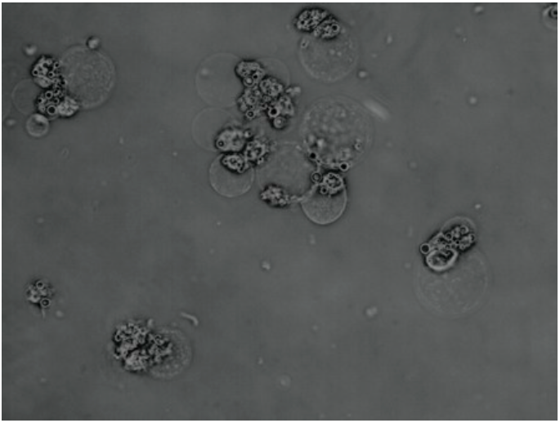
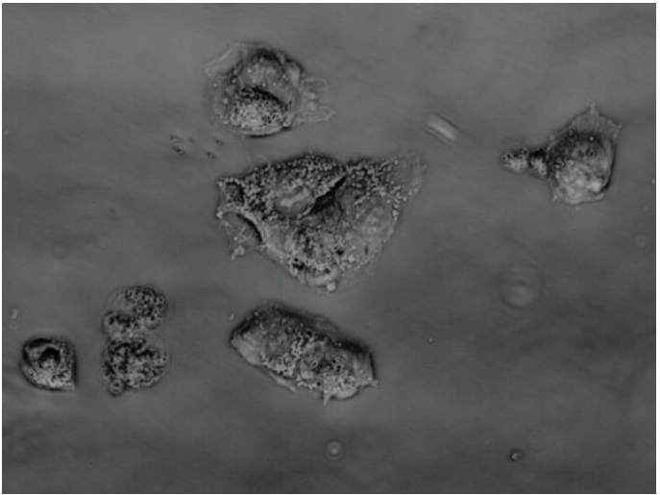
Testing the effect of Perhexiline on HepG2 cell lines
24 Hours
48 Hours
24 Hours
48 Hours
*
*
*
*
Cell viability
Cell viability
*
*
*
*
*
Concentrations
Concentrations
20 µM Perhexiline maleate salt
DMSO
Agren & Mardinoglu et. al (2014), Mol Syst Biol, 10:721
62

Slide 63
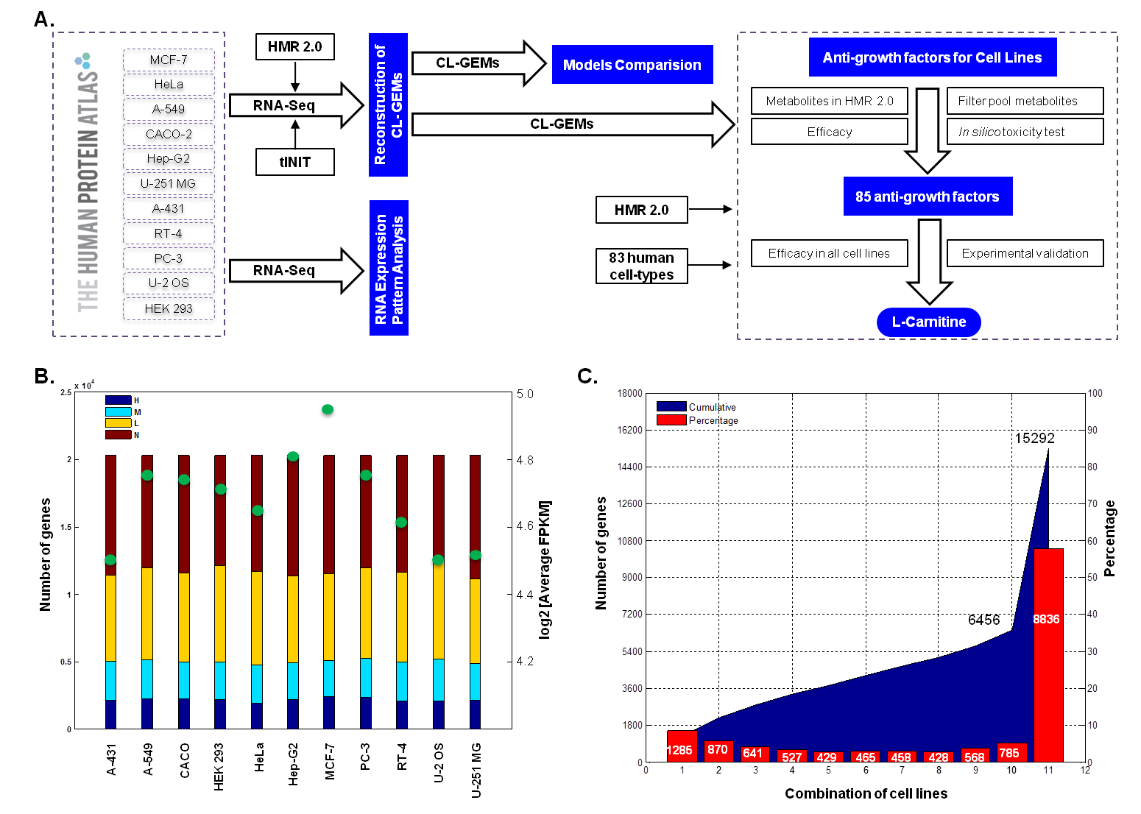
GEMs for human cancer cell lines
Ghaffari et. al (2015), Sci. Rep., 5:8183

Slide 64
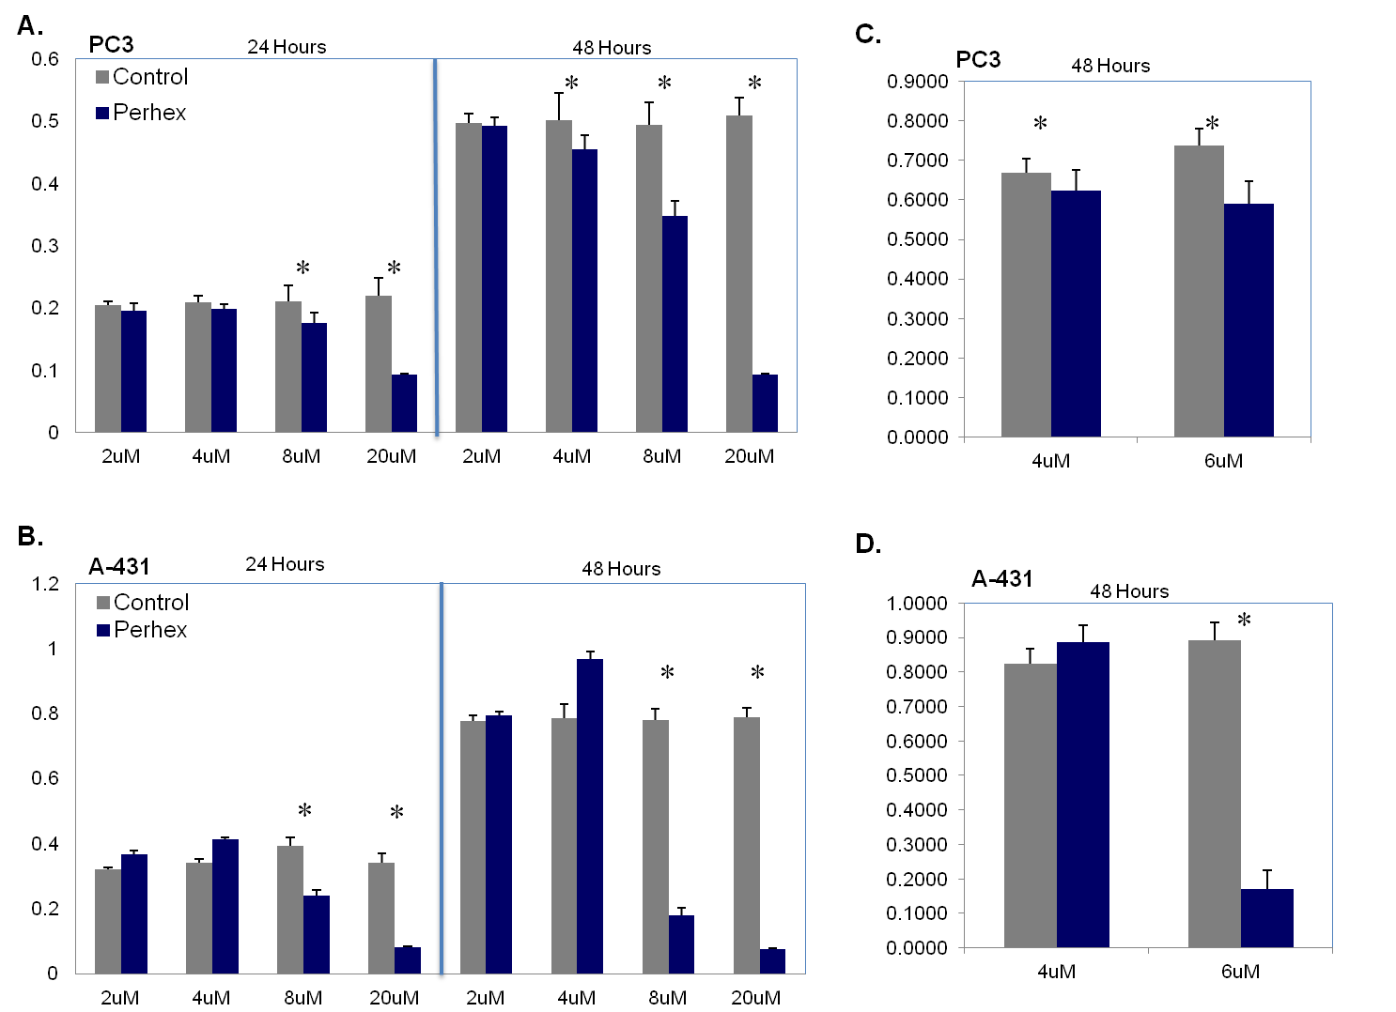
The effect of L-carnitine in human cancer cell lines
Ghaffari et. al (2015), Sci. Rep., 5:8183

Slide 65
Workflow-4: Use of GEMs for Studying Cancer Metabolism
65

Slide 66
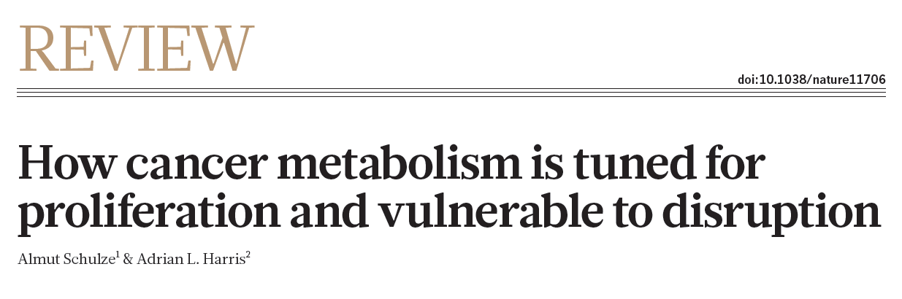
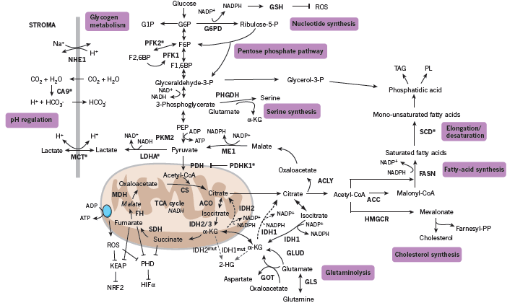
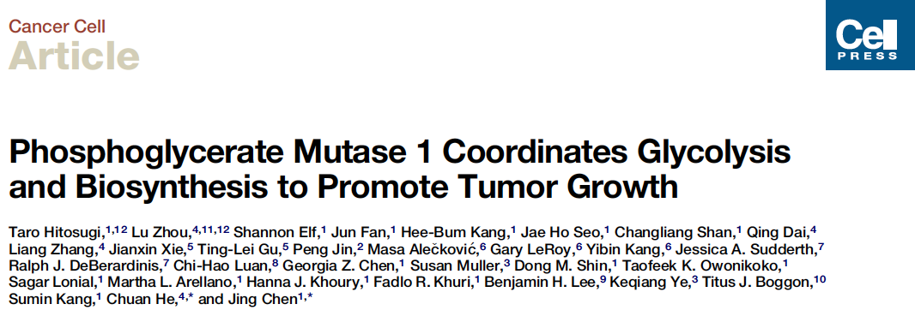
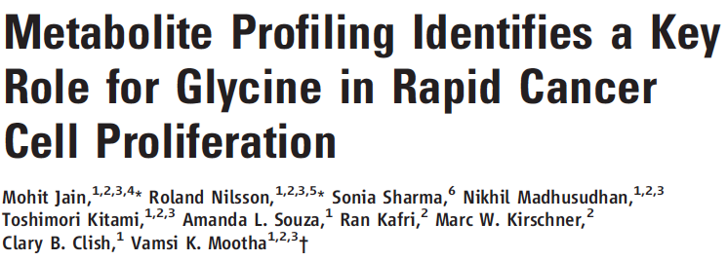
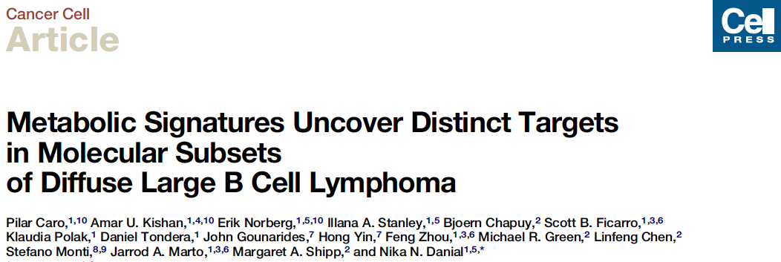

Cancer Metabolism is Gaining Traction
66
Notes:
All these papers were published in 2012

Slide 67
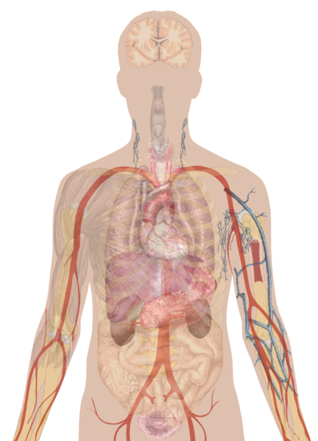
Is Metabolism of Cancer Cells Different from Normal Cells
RNAseq “metabolic” transcriptome of 10 cancers and control
PCA of genes in HMR
Head and Neck Squamous Cell Carcinoma
Lung Squamous Cell Carcinoma
Normal
Lung Adenocarcinoma
Breast Invasive Carcinoma
Tumor
Liver Hepatocellular Carcinoma
Kidney Renal Clear Cell Carcinoma
Kidney Renal Papillary Cell Carcinoma
Uterine Corpus Endometriod Carcinoma
Rectum Adenocarcinoma
ccRCC
Colon Adenocarcinoma
Clear cell Renal Cell Carcinoma (kidney cancer) deviates and do not show a clear distinction in terms of transcription of metabolic genes
67
Notes:
Control samples were available for all but 4 cancer types
Transcript for metabolic genes
ccRCC=clear cell Renal Cell Carcinoma

Slide 68
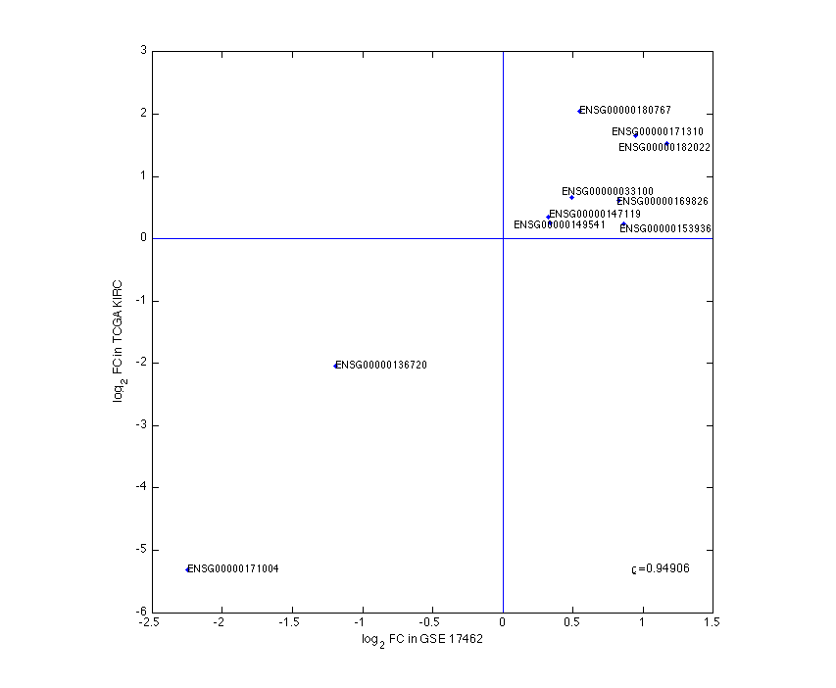
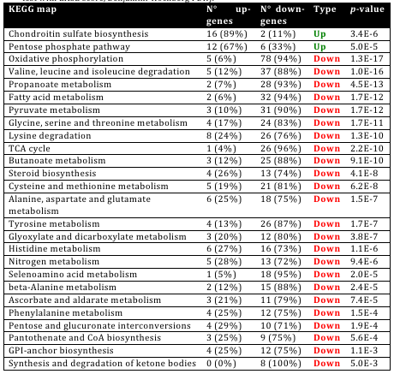
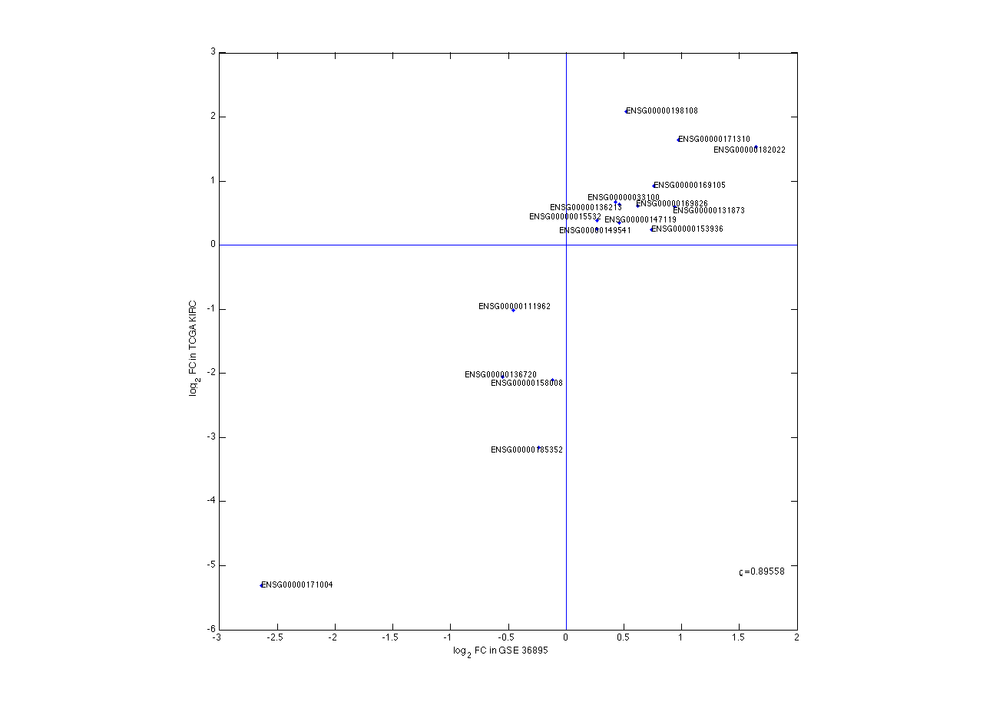
Detailed Analysis of ccRCC
Detect transcriptionally regulated hot-spots in the metabolic network
Confirmed by two other data-sets
Reporter subnetwork
log₂FC GSE14762
ρ = 0.94
Heparin sulfate biosynthesis
Role of chondroitin sulfate in ccRCC is not clear
log₂FC GSE36895
Chondroitin sulfate biosynthesis
ρ = 0.96
log₂FC
68
Notes:
Reporter SubNet cross-validated with GEO Microarray Datasets
Red to left is chondrotin
Green is heparin sulfate
Correlation with two independent studies correlate with the cancer genome atlas

Slide 69


Cancer is Associated with Many Different Metabolic Changes
We identified >2,000 genes in the HMR to be changed in 66 tumors of ccRCC
Interestingly, ccRCC regulated some metabolic genes in different directions
The two cluster correlate with tumor stage
(p = 0.00023)
4
3
2
1
69
Notes:
Clustergram is showing log2FC of metabolic genes within ccRCC compared to control. Hypergeometric test
66 samples of Kidney cancer
Significant genes on the left (around 2000 genes)
Orange bars – tumor stage (3 and 4 is out of the kidney -> metastasis)

Slide 70

Metabolism of Cancer Cell Lines
Jain et al analyzed metabolic consumption and release (CORE) across the NCI-60 cell lines
Quite similar CORE profiles for 111 metabolites
May be reflected by the use of cell lines that may behave differently than tumors in terms of metabolism
Jain et al. (2012) Science 336:1040-1044
70

Slide 71


Transcriptionally Regulated Hot-Spots in Metabolism
We identified reporter metabolites using iHuman3668. Was done for low tumor stage and high tumor stage cancers individually
Reporter metabolites
Low Tumor Stage
High
Tumor
Stage
Glycine and THF metabolism
71
Notes:
Reporter metabolites point to Betaine, Dimethylglycine, Homocysteine
Directional reporter metabolites

Slide 72

Low Tumor Stage Network
[m]
[c]
[ex]
Fold change
p-value
Specificity of regulation direction
-2 -1 0 1 2
10⁻³ 10⁻⁵⁰
All ccRCC Only at this TS
72
Notes:
TS = Tumor Stage

Slide 73
High Tumor Stage Network
[m]
[c]
[ex]
Fold change
p-value
Specificity of regulation direction
-2 -1 0 1 2
10⁻³ 10⁻⁵⁰
All ccRCC Only at this TS
73
Notes:
Note Betain -> Dimethylglycine flip

Slide 74

Evaluating CNVs
Search for CNVs in ccRCC
74
Notes:
108 metabolic genes have CNV – all blue (deletions)

Slide 75
A CNV was Identified in the Glycine/THF network
Identify deleted loci of metabolic genes and estimate the effect in the network
75

Slide 76
What Does it Mean?
Betaine
aldehyde
Choline
Betaine
Methionine
Phospholipids
Sarcosine
Ethanolamine
uptake
Glycine
Serine
Proteins
Purins
Glutathione
76

Slide 77
What Does it Mean?
Upon cell proliferation there is an increased demand for phospholipids and hence for choline, ethanolamine and serine
Betaine
aldehyde
X
Choline
Betaine
Methionine
Phospholipids
Sarcosine
Ethanolamine
Jain et al. (2012) measured in cancer cell lines an increased glycine uptake that is incorporated into purins and glutathione
uptake
Glycine
Serine
Proteins
Purins
Glutathione
77

Slide 78

What Does it Mean?
Jain et al. (2012) reports that mitochondrial glycine biosynthesis is up-regulated
They further find that up-regulation of these genes is associated with increased mortality of breast cancer
It may well be that it is in fact not glycine biosynthesis that is increased, but biosynthesis of serine needed for phospholipids that is increased (explains the increased glycine uptake by their CORE analysis)
Mitochondrial up-regulation may be required in order to drive the reaction glycine to serine for thermodynamic reasons
Jain et al. (2012) Science 336:1040-1044
78

Slide 79

Stratification of HCC patients based on acetate utilization

Slide 80

DIRAC Algorithm reveals network deregulation of central metabolic pathways in HCC

Slide 81

Pathophysiology of HCC with high ACSS1 expression

Slide 82

Workflow-5: Reconstruction of tissue-specific GEMs
based on RNA-seq data
Number of reactions
Number of models
Number of genes
Number of models
Uhlen et. al (2015), Science, 347, 1260419
82

Slide 83

Uhlen et. al (2015), Science, 347, 1260419
83

Slide 84


Metabolic functions of the tissue models
Uhlen et. al (2015), Science, 347, 1260419

Slide 85

Classification of the genes in WAT
Mardinoglu et. al (2014), J. Proteome Res. 13, 5106−5119
85

Slide 86

Validation of the Adipocyte GEM
Mardinoglu et. al (2014), J. Proteome Res. 13, 5106−5119
86

Slide 87

Amino acid Metabolism in Obese subjects
Mardinoglu et. al (2014), J. Proteome Res. 13, 5106−5119
87

Slide 88

BCAA Metabolism in the Adipose Tissue of Obese subjects
We also downloaded gene expression data from liver and muscle tissue of obese subjects and we could not see any significant changes in the gene expression profile.
88

Slide 89

Amino acid Metabolism in Obese subjects
Mardinoglu et. al (2014), J. Proteome Res. 13, 5106−5119
89

Slide 90

Update in the model for crosstalk between lipids and BCAA in Obesity
Newgard C. (2012), Cell Met. 15, 612
90

Slide 91
Metabolic differences in SAT and VIS AT in response to two step Bariatric Surgery
A.
B.
Probes in SAT
Probes in VAT
6 subjects
SAT
VAT
2nd OP SAT
1st OP SAT
2nd OP VAT
1st OP VAT
1st OP
2nd OP
Sample 1
Sample 2
48
83
149
36
103
152
C.
SAT
VAT
25416
25606
SAT | VAT
25696 Probes | 25897 Probes
280 differentially expressed probes | 291 differentially expressed probes
223 Protein coding genes | 204 Protein-coding genes
45 genes in iAdipocytes1809 | 34 genes in iAdipocytes1809
26
19
15
Mardinoglu et. al (2015), Under review
91

Slide 92
Metabolic differences in SAT and VIS Fat
Up regulated in SAT and VAT
Glucose
Up regulated in SAT only
Cytoplasm
NAD+
NADH
H+
Glycolysis
sn-Glycerol-3P
DHAP
ALDOC
TAG
GPD1L
fructose-1,6-bisphosphate
GAP
3-phospho-D-glycerate
CDP-choline
DGAT2
Acyl-CoA
GLYCTK
PC
OAA
glycerate
CEPT1
PS
Serine
DAG
CEPT1
Acetyl-CoA
Citrate
TCA cycle
PE
Citrate
CDP-ethanolamine
LPIN1
PI
PEP
CIDEA
Phosphatidate
Malonyl-CoA
PCK2
OAA
LDs
ABHD5
Acyl-CoA
1-Acylglycerol-3P
FA Synthesis
Acetyl-CoA
Pyruvate
AGPAT9
FA Desaturation
HADH
ALDH6A1
LDL
LDLR
SCD
Carnitine shuttle
3-oxopropanoate[m]
FA
CD36
SLC27A2
Acyl-CoA
Acyl-CoA
Mitochondria
FA
Mardinoglu et. al (2015), Under review
92

Slide 93
Metabolic differences in SAT and VIS AT in response to two step Bariatric Surgery
SC Fat
VIS Fat
*
*
*
*
*
*
*
*
*
*
*
Up regulated in obese subjects
Down regulated in obese subjects
ATP[c]
ADP[c] + Pi[c]
ATP[c]
ADP[c] + Pi
NADP+[c]
NADPH[c]
GSR
Glutamine[c]
Glutamate[c]
gamma-glutamyl-cysteine[c]
GSH[c]
GSSG[c]
GCLC
GCLM
GSS
GPX1-8
Cysteine[c]
Glycine[c]
H2O2
CAT
2H2O
O2
Mardinoglu et. al (2015), Under review
93

Slide 94

Workflow-6: Muscle Metabolism in Response to T2D
Myoblasts isolated from skeletal muscle of 24 subjects (both genders covered)
12 obese (6 NGT and 6 T2D)
12 non-obese (6 NGT and 6 T2D)
RNA isolated from the myocytes before and after insulin stimulation
Varemo et. al (2014), Cell Reports
94

Slide 95


RNA-Seq used to refine HPA data
Very high quality of the RNAseq (non-obese NGT subjects) expression in the myocytes
No major differences between males and females
Consistent expression in all 6 subjects
Varemo et. al (2014), Cell Reports
95

Slide 96
Protein and RNA-Seq Correlation
Based on the RNA-Seq density plot we selected FPKM>1 as indication of protein presence
Protein detection in HPA are divided into uncertain and supportive
For proteins in the supportive group there is a very good correlation with RNA-Seq expression with FPKM>1
Varemo et. al (2014), Cell Reports
96

Slide 97

Comparison with other models
Reactions
Genes
Ongoing: The 78 negative genes are checked again by HPA.
This far, 18 (of the 78 genes) have been reclassified as detected and will be updated in the next HPA version.
Also, 38 (of the 78 genes) genes have FPKM>1
Varemo et. al (2014), Cell Reports
97

Slide 98


Meta analysis of T2D muscle gene expression
Inflammation also identified in metabolism:
Prostaglandins
Leukotriene
Energy metabolism reduced
Varemo et. al (2014), Cell Reports
98

Slide 99

Workflow-7: Conventionally Raised
& Germ Free Mice
Mardinoglu et. al (2015),
99

Slide 100

Analysis of gene expression data
Mardinoglu et. al (2015), For Submission
100

Slide 101

Analysis of gene expression data
Mardinoglu et. al (2015), For Submission
101

Slide 102
Significantly changed genes in All Tissues
CONV-R - GF
ADP[c]
Pi
ADP[c]
Pi
ATP[c]
ATP[c]
Duodenum
Jejunum
Ileum
Colon
Liver
Subcutaneous fat
Glutamine[c]
Glutamate[c]
gamma-glutamyl-
cysteine[c]
GSH[c]
GCLC
GCLM
GSS
Cysteine[c]
Glycine[c]
NADH[m]
Nnt
NADP+[m]
2 GSH[m]
H2O2[m]
H+[c]
MMR_4271
H+[m]
Gsr
Gpx1-8
MMR_4121
Cat
MMR_3870
NADPH[m]
2 H2O[m]
O2[m]
GSSG[m]
NAD+[m]
Entpd4
Nucleoside diphosphate[c]
MMR_3998
Nucleoside phosphate[c]
ADP[c]
AMP[c]
H2O[c]
Pi[c]
Nnt uses the energy to transfer reducing equivalents from NADP+ to NADPH. The increased reducing potential of NADPH is then used to
reduce oxidized glutathione for the reduction of H2O2 to H2O,
change the thiol-disulfide balance of amino acids in proteins to regulate transcription factors
drive macromolecular synthesis.
C57BL/6J mouse strain had the naturally occurring deletion in Nnt and it exhibits an impaired glucose tolerance that is independent of obesity.
Knockdown of Nnt by siRNA (small interfering RNA) in the insulin-secreting β-cell line MIN6 results in reduced insulin secretion.
Mardinoglu et. al (2015), For Submission
102

Slide 103
Network Dependent Analysis: Liver Tissue
CONV-R - GF
Gene | Subsystem
Slc2a1 | Glucose transporter
Slc16a12 | Acetate transporter
Hmgcr | Cholesterol synthesis
Cyp7a1 | Bile acid synthesis
Akr1d1 | Bile acid synthesis
Sdr9c7 | Propanoate metabolism
Elovl3 | Fatty acid synthase
R-S-glutathione[m]
HX
Gstp1
MMR_XXX
NADH[m]
RX
Nnt
NADP+[m]
2 GSH[m]
H2O2[m]
H+[c]
MMR_4271
H+[m]
Gsr
Gpx6
MMR_4121
MMR_3870
NADPH[m]
GSSG[m]
2 H2O[m]
NAD+[m]
Entpd4
ADP[c]
MMR_3998
AMP[c]
H2O[c]
Pi[c]
Sult1e1
Sult1b1
Papss1
adenylyl sulfate[c]
MMR_4185
PAPS[c]
MMR_XXX
PAP[c]
ATP[c]
ADP[c]
estrone[c]
3,5-diiodo-L-thyronine[c]
estrone 3-sulfate[c]
3,5-diiodo-L-thyronine-4-O-sulfate[c]
Mardinoglu et. al (2015), For Submission
103

Slide 104
Network Dependent Analysis: Colon Tissue
CONV-R - GF
Gene | Subsystem
Ace2 | Transcription factor
Arg2 | Arginine metabolism
Ces1g | Retinol metabolism
Rbp4 | Retinol metabolism
Hsd17b7 | Cholesterol synthesis
Nsdhl | Cholesterol synthesis
Sc4mol | Cholesterol synthesis
Hmgcs1 | Cholesterol synthesis
Mgam | Starch and sucrose metabolism
Sis | Starch and sucrose metabolism
Slc2a5 | Fructose metabolism
Slc2a9 | Fructose metabolism
Sord | Fructose metabolism
Khk | Fructose metabolism
Aldob | Glycolysis / Gluconeogenesis
Aldh9a1 | Glycolysis / Gluconeogenesis
DOWN | Lipid metabolism
R-S-glutathione[m]
Gsta4
Gstk1
Gstp1
Gstt1
HX
NADH[m]
MMR_XXX
RX
Nnt
NADP+[m]
2 GSH[m]
H2O2[m]
H+[c]
MMR_4271
H+[m]
Gsr
MMR_4121
MMR_3870
NADPH[m]
GSSG[m]
2 H2O[m]
NAD+[m]
Acsf2
Impdh2
Entpd4
ADP[c]
MMR_3998
AMP[c]
NAD+[c]
MMR_XXX
NADH[c]
H2O[c]
Pi[c]
X[c]
Y[c]
Akr1b8 Cbr3
NADPH[c]
H2O2[c]
O2[c]
Lpo
NADP+[c]
NADPH[c]
Duox2
MMR_7701
MMR_XXX
H2O2[c]
Cyp2c55 Cyp2d22
Blvrb
NADP+[c]
H2O[c]
Mardinoglu et. al (2014), For Submission
104

Slide 105
Network Dependent Analysis: Small intestine
CONV-R - GF
Gsta2,Gsta3 Gsta4, Gstk1 Gstm2, Gsto1
Gstp1, Gstt1
R-S-glutathione[m]
HX
Duodenum
Jejunum
MMR_XXX
NADH[m]
RX
Nnt
NADP+[m]
Gsr
2 GSH[m]
H2O2[m]
H+[c]
MMR_4271
H+[m]
MMR_3870
Gpx2
MMR_4121
NADPH[m]
GSSG[m]
2 H2O[m]
NAD+[m]
Entpd4
Nucleoside diphosphate[c]
MMR_3998
Nucleoside phosphate[c]
Ileum
ADP[c]
AMP[c]
H2O[c]
Pi[c]
Mardinoglu et. al (2014), For Submission
105

Slide 106




















Systems medicine group@ SciLifeLab
Computational Biology
Cheng Zhang
Senior Researcher
Sunjae Lee
Senior Researcher
Ida Larsson
MSc Student
Reza Bidkhori
Post doc
Rui Benfeitas
Post doc
Muhammad Arif
PhD stud.
Alen Lovric
Research Eng
Dorines Rosario
Research Eng
Mohamed Alshobky
MSc Student
Experimental Biology
Beste Turanli
Vis Student
Feride Eren
Vis Student
Ozlem Altay
Vis Resarcher
Shuqi Zhang
Vis Resarcher
Zhengtao Liu
Post doc
Woong Hee Kim
Post doc
Natasa Sikanic
Researcher
Medicinal Chemistry
Computational Chemistry
Faddy Aziz
Post doc
Umberto Battisti
Post doc
Chiara Zagni
Post doc
Anders Füchtbauer
Post doc
Leticia Gómez
Post doc
Chunxia Gao
Post doc

Slide 107
Acknowledgements
SciLifeLab
Prof. Mathias Uhlen
Ass. Prof. Emma Lundberg
Ass. Prof. Simon Elsässer
Chalmers University of Technology
Prof. Jens Nielsen
University of Groningen
Albert K. Groen
University of Gothenburg
Prof Jan Boren
Prof Ulf Smith
Prof. Fredrik Bäckhed
Prof. Lena M Carlsson
Prof. Stefano Romeo
Prof. Morten Grötli
Prof. Leif Eriksson
University of Amsterdam
Mireille J. Serlie
King's College London
Ass. Prof. Saeed Shoaie
Stanford University
Prof. Michael Snyder
Dr Brian D Piening
NIH
Prof. George Kunos
Dr Resat Cinar
Bani Mukhopadhyay
Helsinki University
Prof Marja-Riitta Taskinen
Imperial College London
Prof. Philippe Froguel
Prof. Andrew J Walley
University of Leipzig
Prof. Matthias Blüher

Slide 108






Acknowledgements
108

